Slide 1
Programming 6
Workshop on CMake
johan.korten@han.nl
V1.0 Nov 2025

Slide 2
Workshop Topics overview
Clean code (beyond SOLID)
CMake
Unit testing
Commentaar
Patterns (Clean architecture)

Slide 3
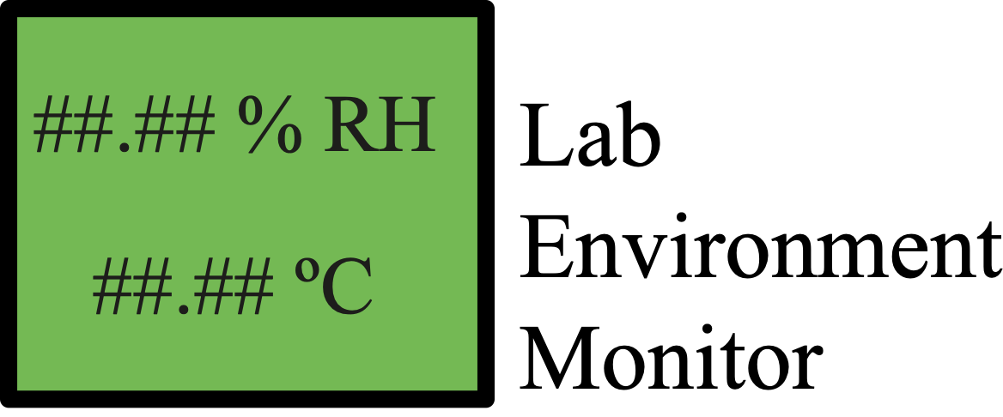
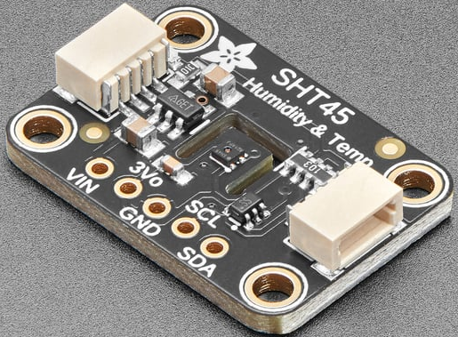
Example project for today
SHT45
- Temperature
- Humidity Sensor

Slide 4
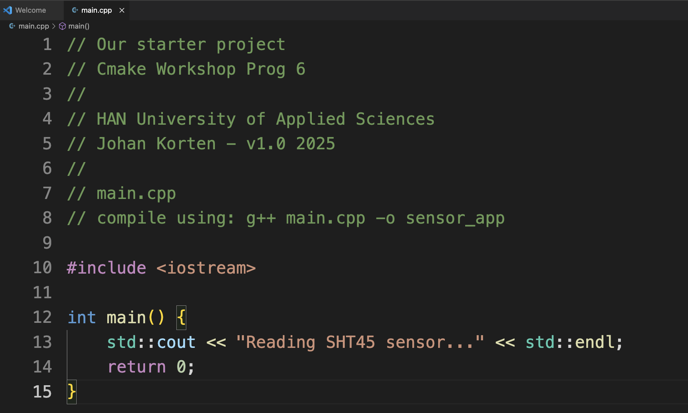
Pragmatic start - Stepping stone 1
SimpleProject

Slide 5
Pragmatic start - Stepping stone 1
Compile and test:
SimpleProject

Slide 6
Towards a library - Stepping stone 2
Compile and test:
SimpleLibrary

Slide 7
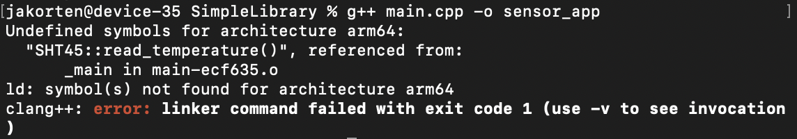
Towards a library - Stepping stone 2
Compile and test: (Whoops…)
SimpleLibrary

Slide 8
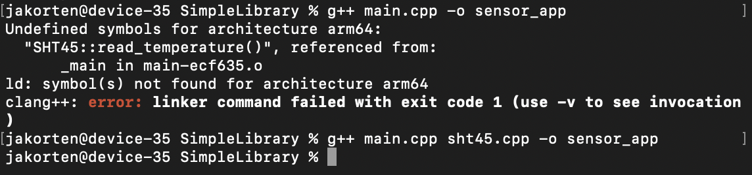
Towards a library - Stepping stone 2
Compile and test: (Pfwiew, we got away for now… )
SimpleLibrary

Slide 9
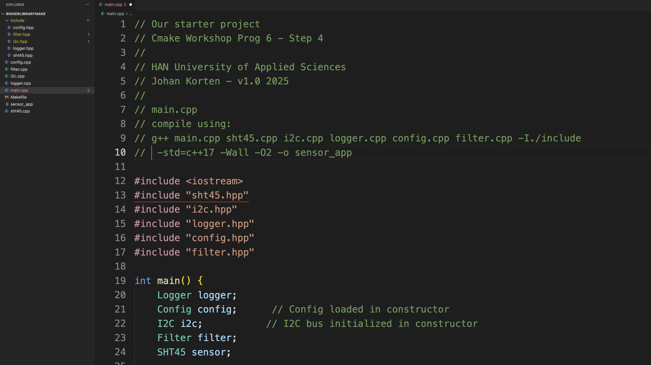
Towards a library - Stepping stone 3
BiggerLibrary

Slide 10
A bigger library - Stepping stone 4
g++ main.cpp sht45.cpp i2c.cpp logger.cpp config.cpp filter.cpp -I./include -std=c++17 -Wall -O2 -o sensor_app
BiggerLibraryMake

Slide 11
Fighting Commandline Nightmares - Stepping stone 5
g++ main.cpp sht45.cpp i2c.cpp logger.cpp config.cpp filter.cpp -I./include -std=c++17 -Wall -O2 -o sensor_app
Alternative: Makefile
# Makefile for Sensor Application
# CMake Workshop - HAN University of Applied Sciences
# Johan Korten - v1.0 2025
# Compiler and flags
CXX = g++
CXXFLAGS = -std=c++17 -Wall -Wextra -O2 -I./include
LDFLAGS =
# Target executable
TARGET = sensor_app
# Source files
SOURCES = main.cpp sht45.cpp i2c.cpp logger.cpp config.cpp filter.cpp
# Object files (replace .cpp with .o)
OBJECTS = main.o sht45.o i2c.o logger.o config.o filter.o
# Header files (for dependency tracking)
HEADERS = include/sht45.hpp include/i2c.hpp include/logger.hpp include/config.hpp include/filter.hpp
# Default target
all: $(TARGET)
# Link object files to create executable
$(TARGET): $(OBJECTS)
$(CXX) $(OBJECTS) $(LDFLAGS) -o $(TARGET)
@echo "Build complete: $(TARGET)"
# Compile main.cpp
main.o: main.cpp $(HEADERS)
$(CXX) $(CXXFLAGS) -c main.cpp
# Compile sht45.cpp
sht45.o: sht45.cpp include/sht45.hpp
$(CXX) $(CXXFLAGS) -c sht45.cpp
# Compile i2c.cpp
i2c.o: i2c.cpp include/i2c.hpp
$(CXX) $(CXXFLAGS) -c i2c.cpp
# Compile logger.cpp
logger.o: logger.cpp include/logger.hpp
$(CXX) $(CXXFLAGS) -c logger.cpp
# Compile config.cpp
config.o: config.cpp include/config.hpp
$(CXX) $(CXXFLAGS) -c config.cpp
# Compile filter.cpp
filter.o: filter.cpp include/filter.hpp
$(CXX) $(CXXFLAGS) -c filter.cpp
# Clean build artifacts
clean:
rm -f $(OBJECTS) $(TARGET)
@echo "Clean complete"
# Rebuild everything from scratch
rebuild: clean all
# Run the application
run: $(TARGET)
./$(TARGET)
# Show help
help:
@echo "Available targets:"
@echo " all - Build the application (default)"
@echo " clean - Remove all build artifacts"
@echo " rebuild - Clean and build from scratch"
@echo " run - Build and run the application"
@echo " help - Show this help message"
.PHONY: all clean rebuild run help

Slide 12
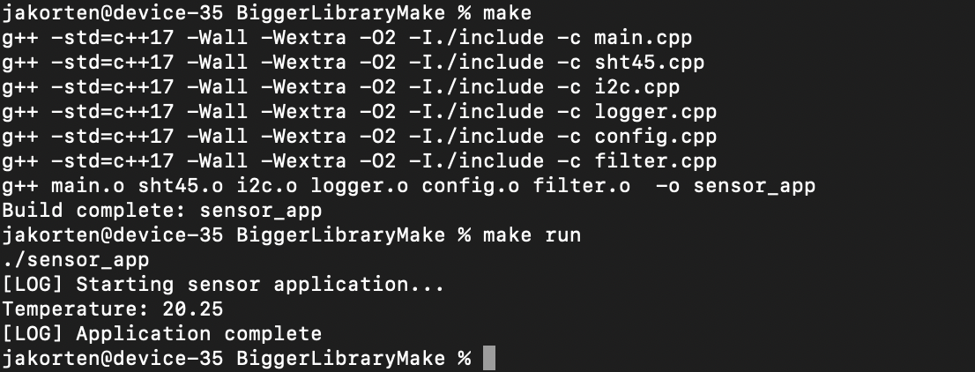
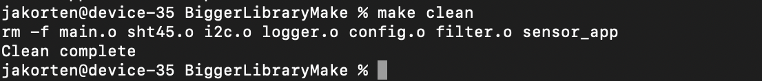
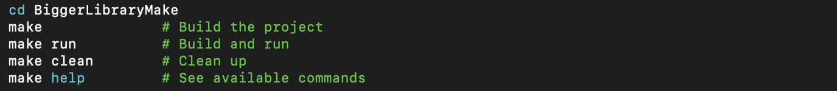
Fighting Commandline Nightmares - Stepping stone 5
BiggerLibraryMake

Slide 13
The problem of makefiles
‘Makefile hell’: 200+ lines for a simple project
IDE lock-in: Can't share code between STM32CubeIDE / VS Code / CLion / whatever.
SimpleProject
Notes:
SOLID, Strong Cohesion, Weak Coupling

Slide 14
Fighting Commandline Nightmares - Stepping stone 5
From the cli nightmare to the make nightmare…
Pro’s:
1. Incremental compilation - Only recompiles changed files
2. Dependency tracking - Recompiles when headers change
3. Clean separation - Variables for compiler, flags, sources
4. Helper targets - clean, rebuild, run, help
5. Standard conventions - Uses CXX, CXXFLAGS, etc.
Con’s:
1. Manual listing - Every .cpp and .o file must be listed
2. Repetitive rules - 6 nearly identical compilation rules
3. Manual dependency tracking - Have to specify which .cpp depends on which .hpp
4. Platform-specific - Won't work on Windows without changes
5. Hard-coded compiler - g++ might not be available everywhere
6. Tedious maintenance - Add new file = edit 3+ places in Makefile

Slide 15
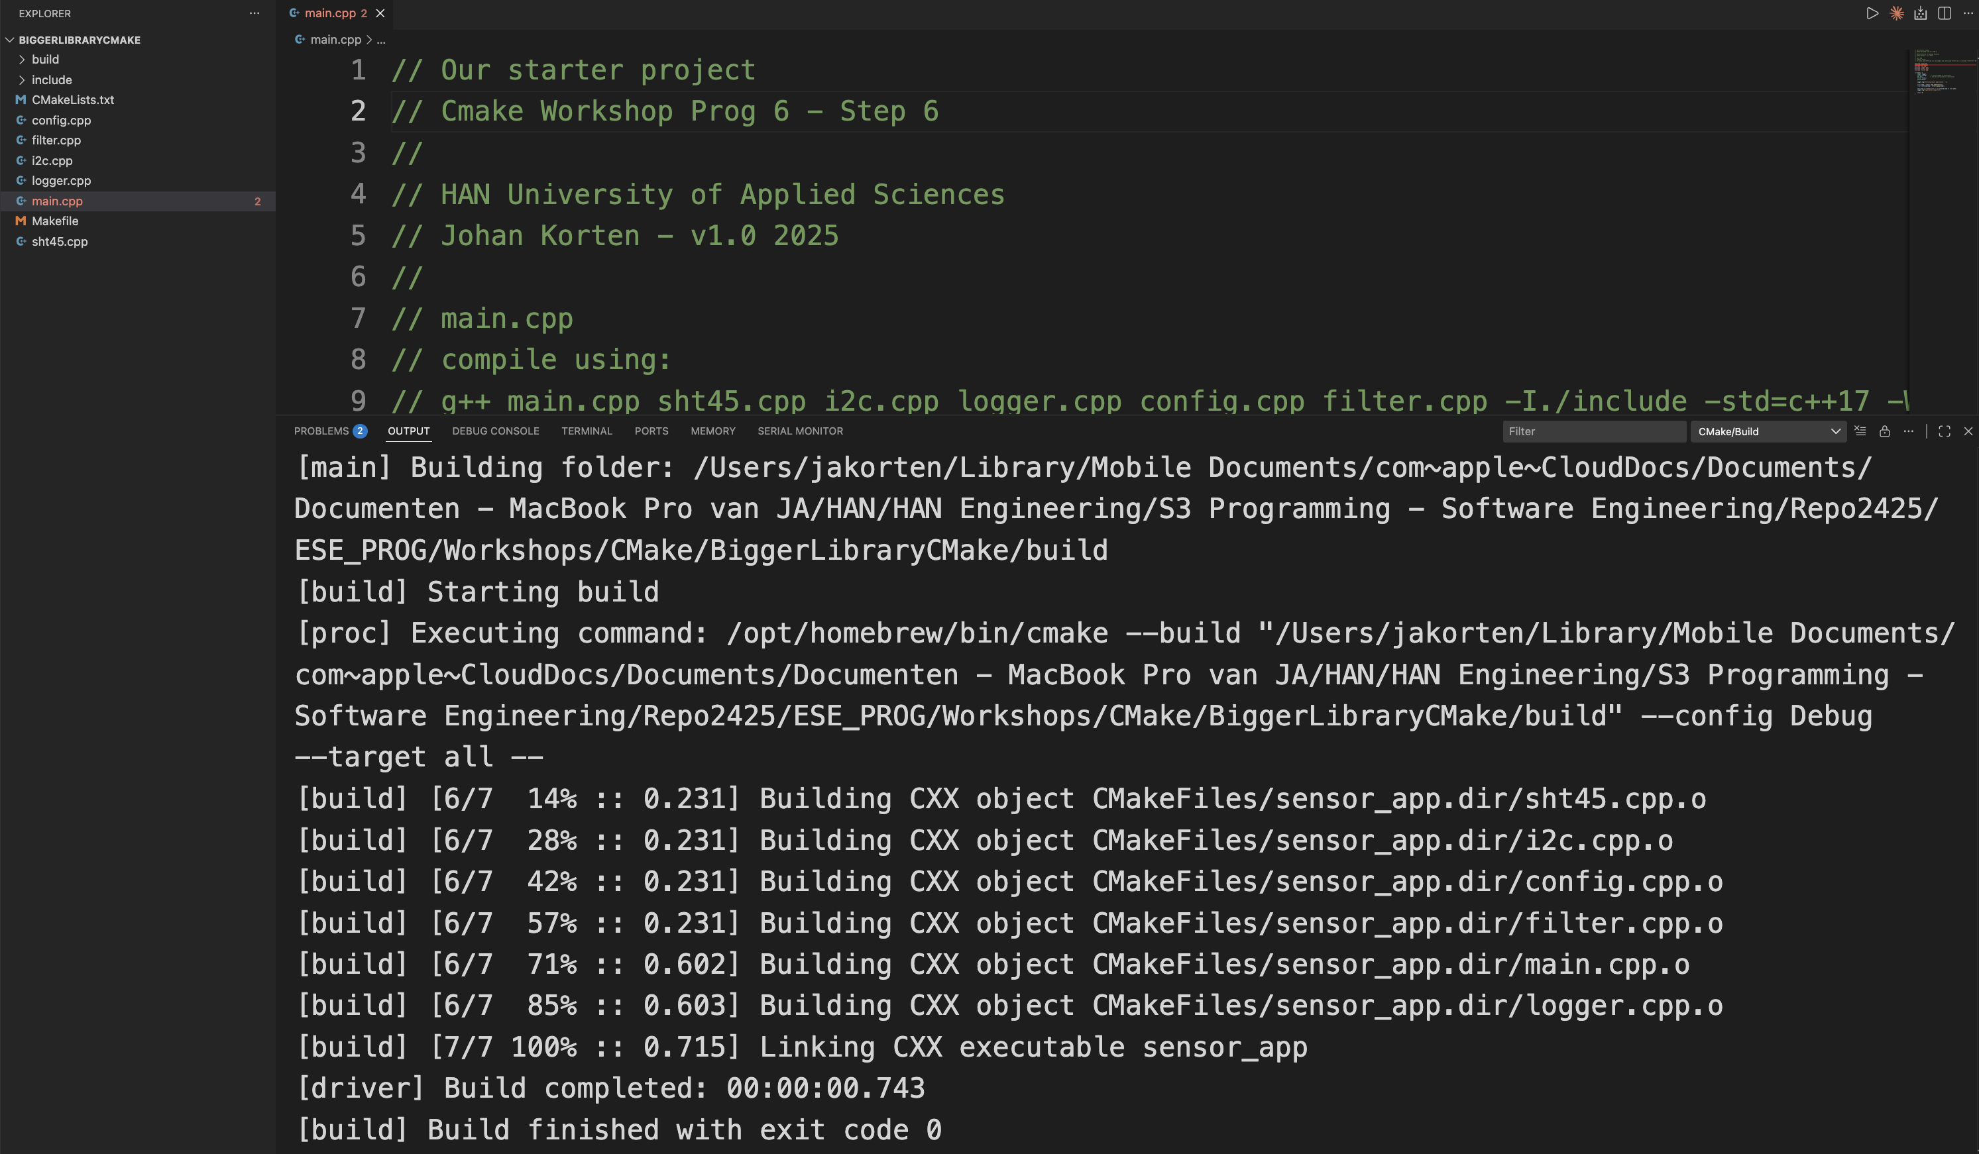
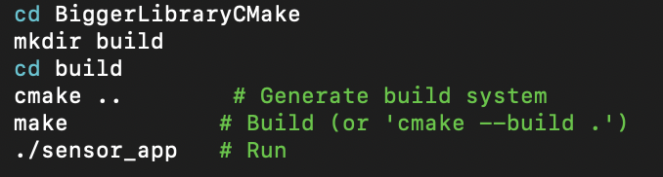
Towards a library - Stepping stone 6
BiggerLibraryCMake

Slide 16
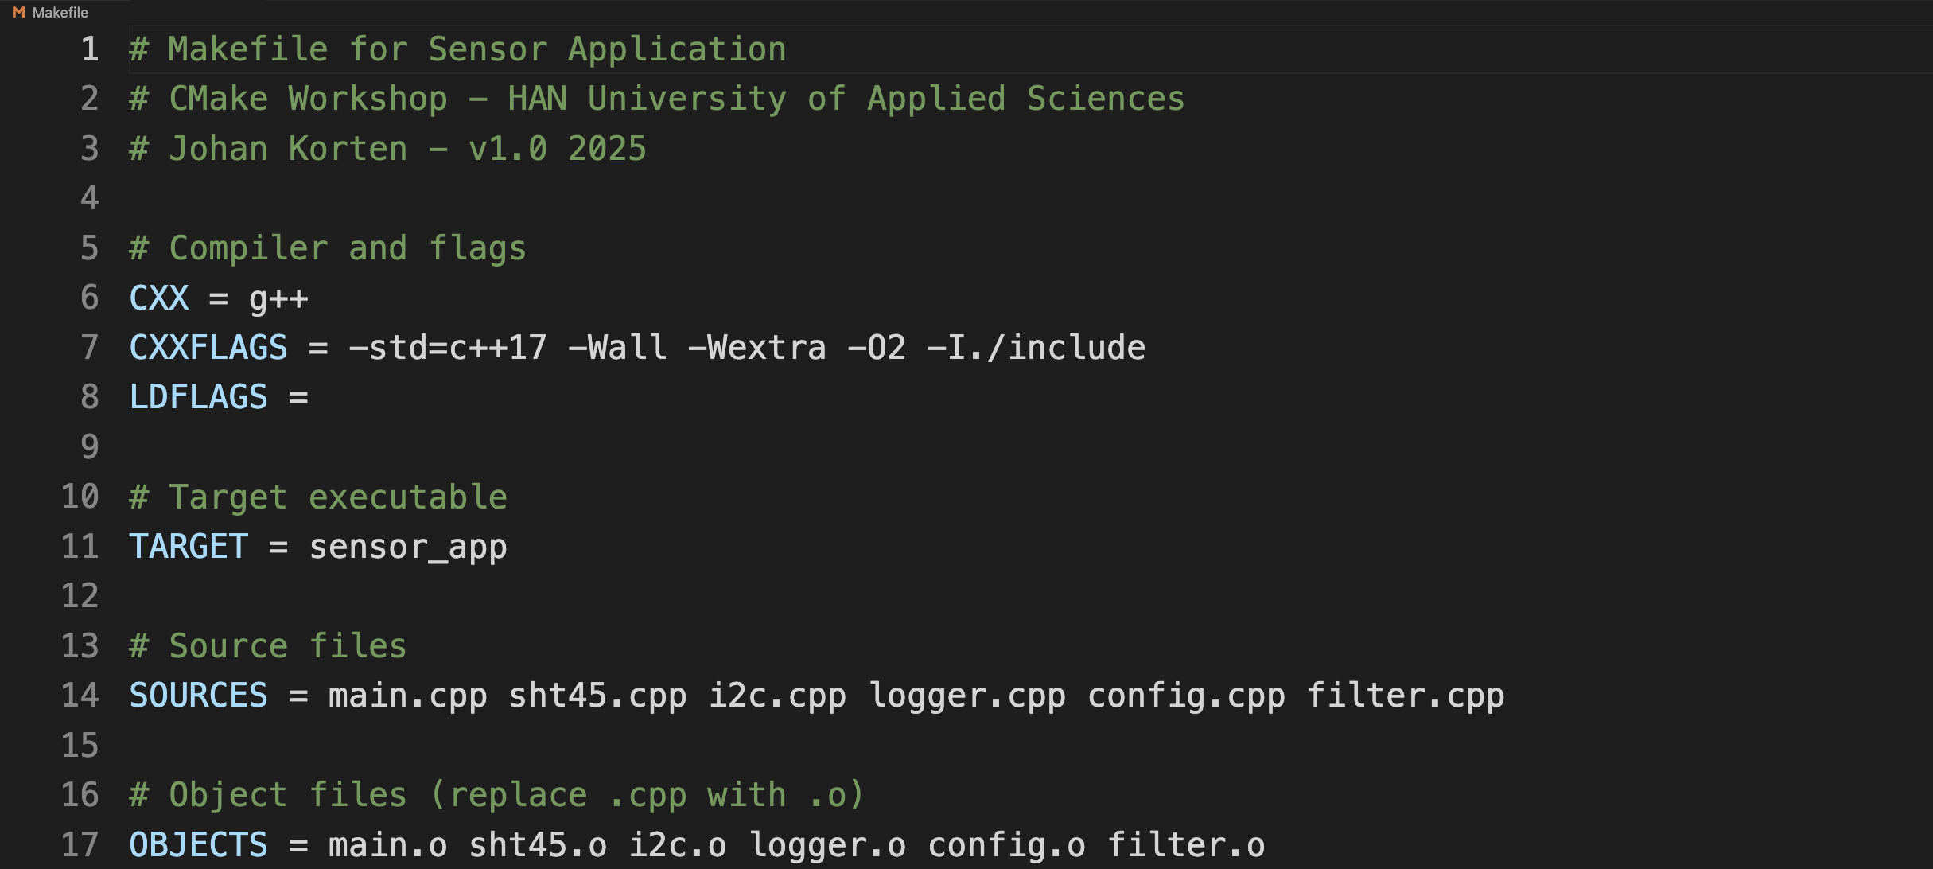
Towards a library - Stepping stone 6
Makefile 1/5 1..17
BiggerLibraryCMake

Slide 17
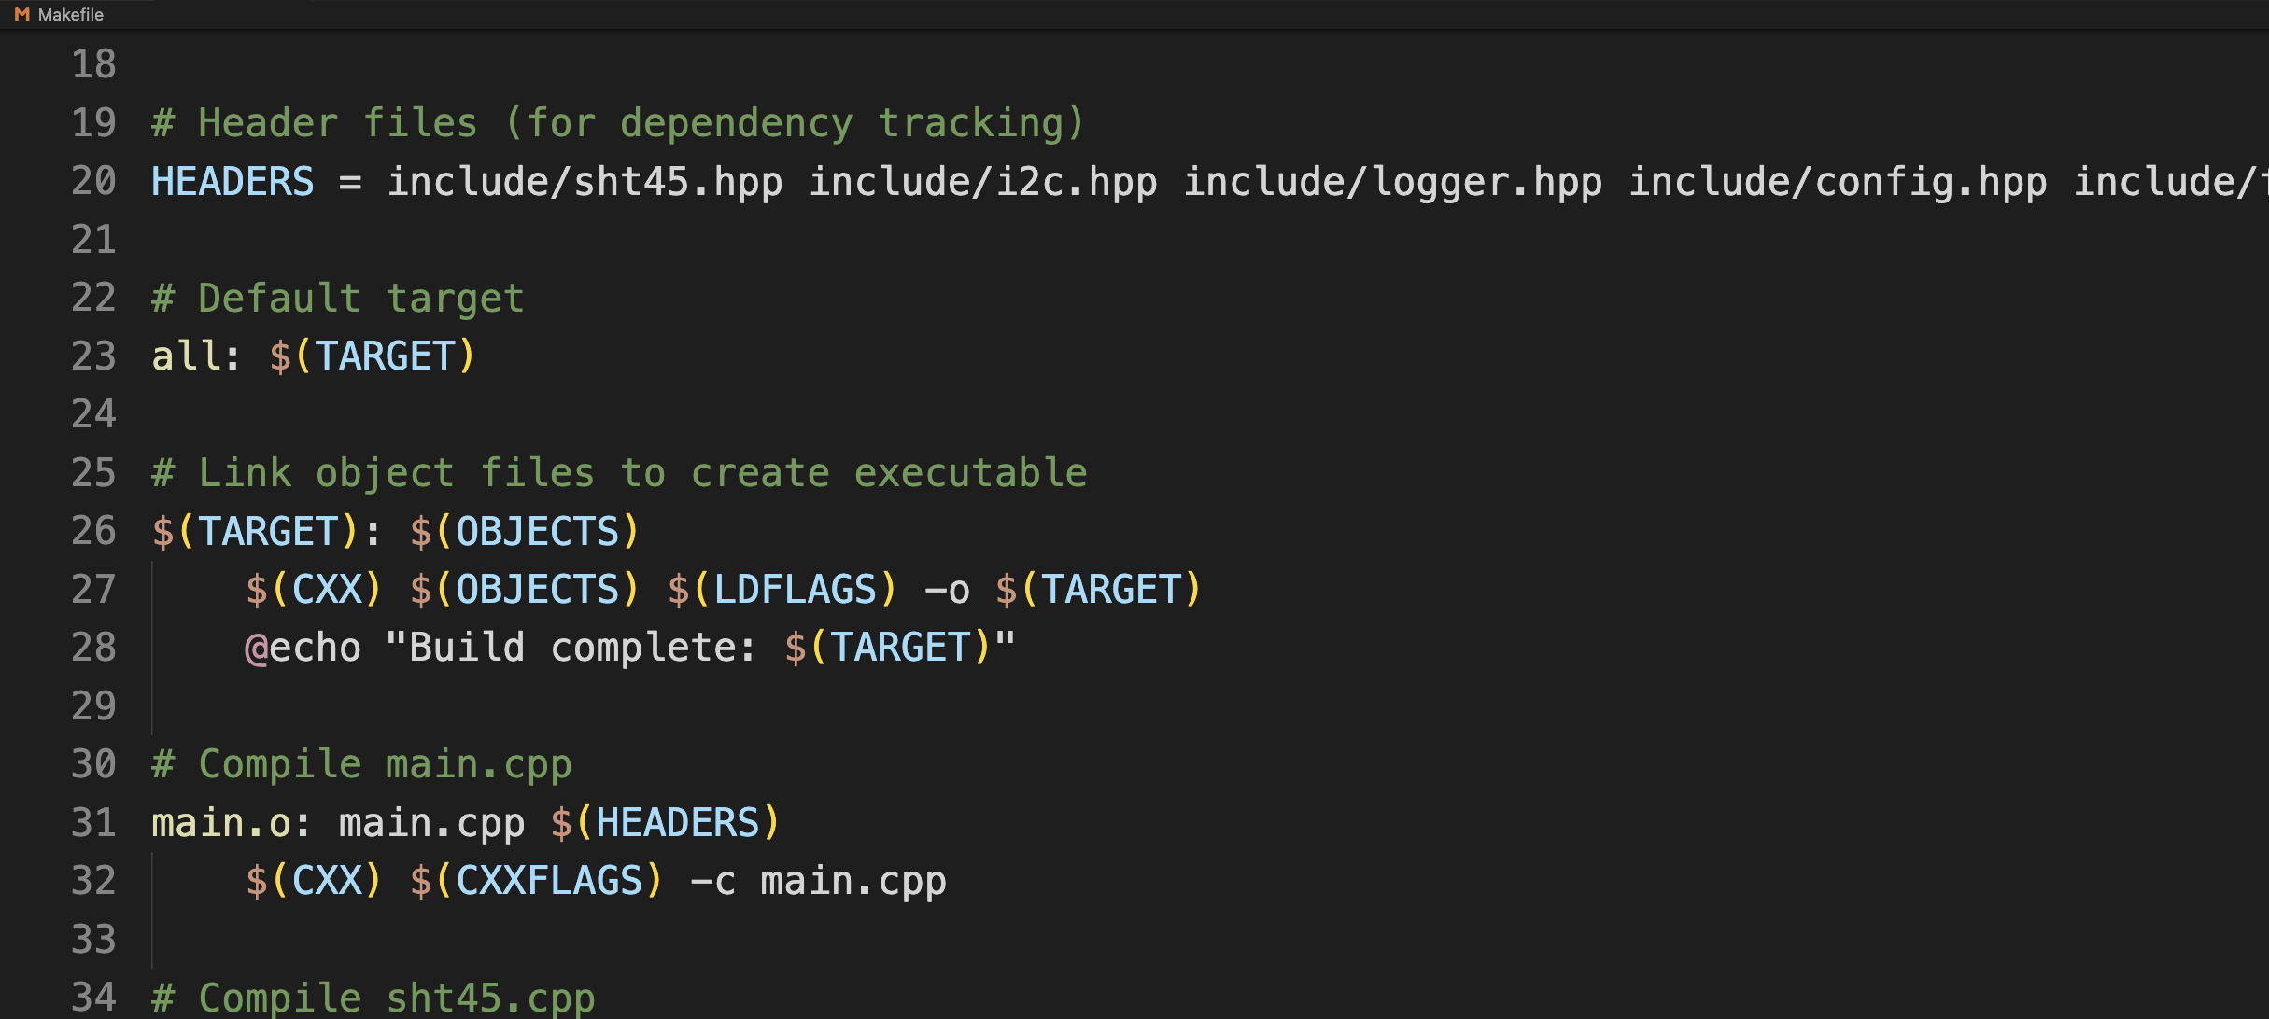
Towards a library - Stepping stone 6
Makefile 2/5 18..33
BiggerLibraryCMake

Slide 18
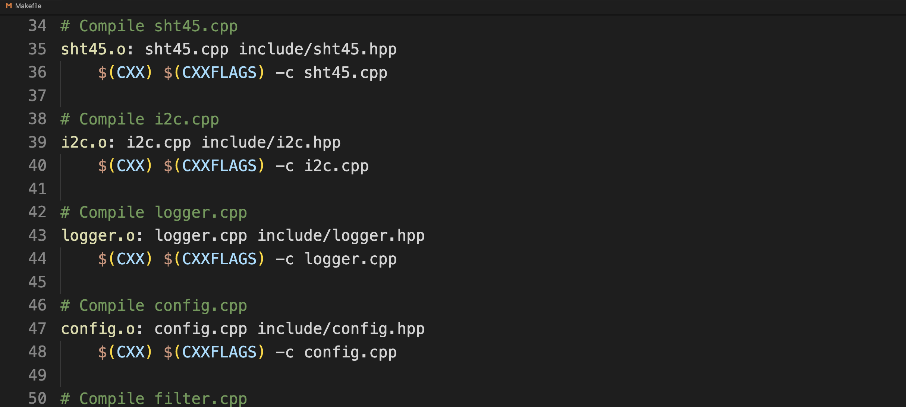
Towards a library - Stepping stone 6
Makefile 3/5 34..49
BiggerLibraryCMake

Slide 19
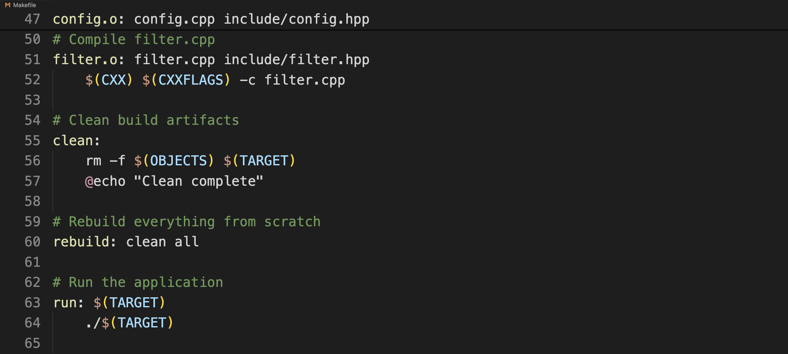
Towards a library - Stepping stone 6
Makefile 4/5 47..64
BiggerLibraryCMake

Slide 20
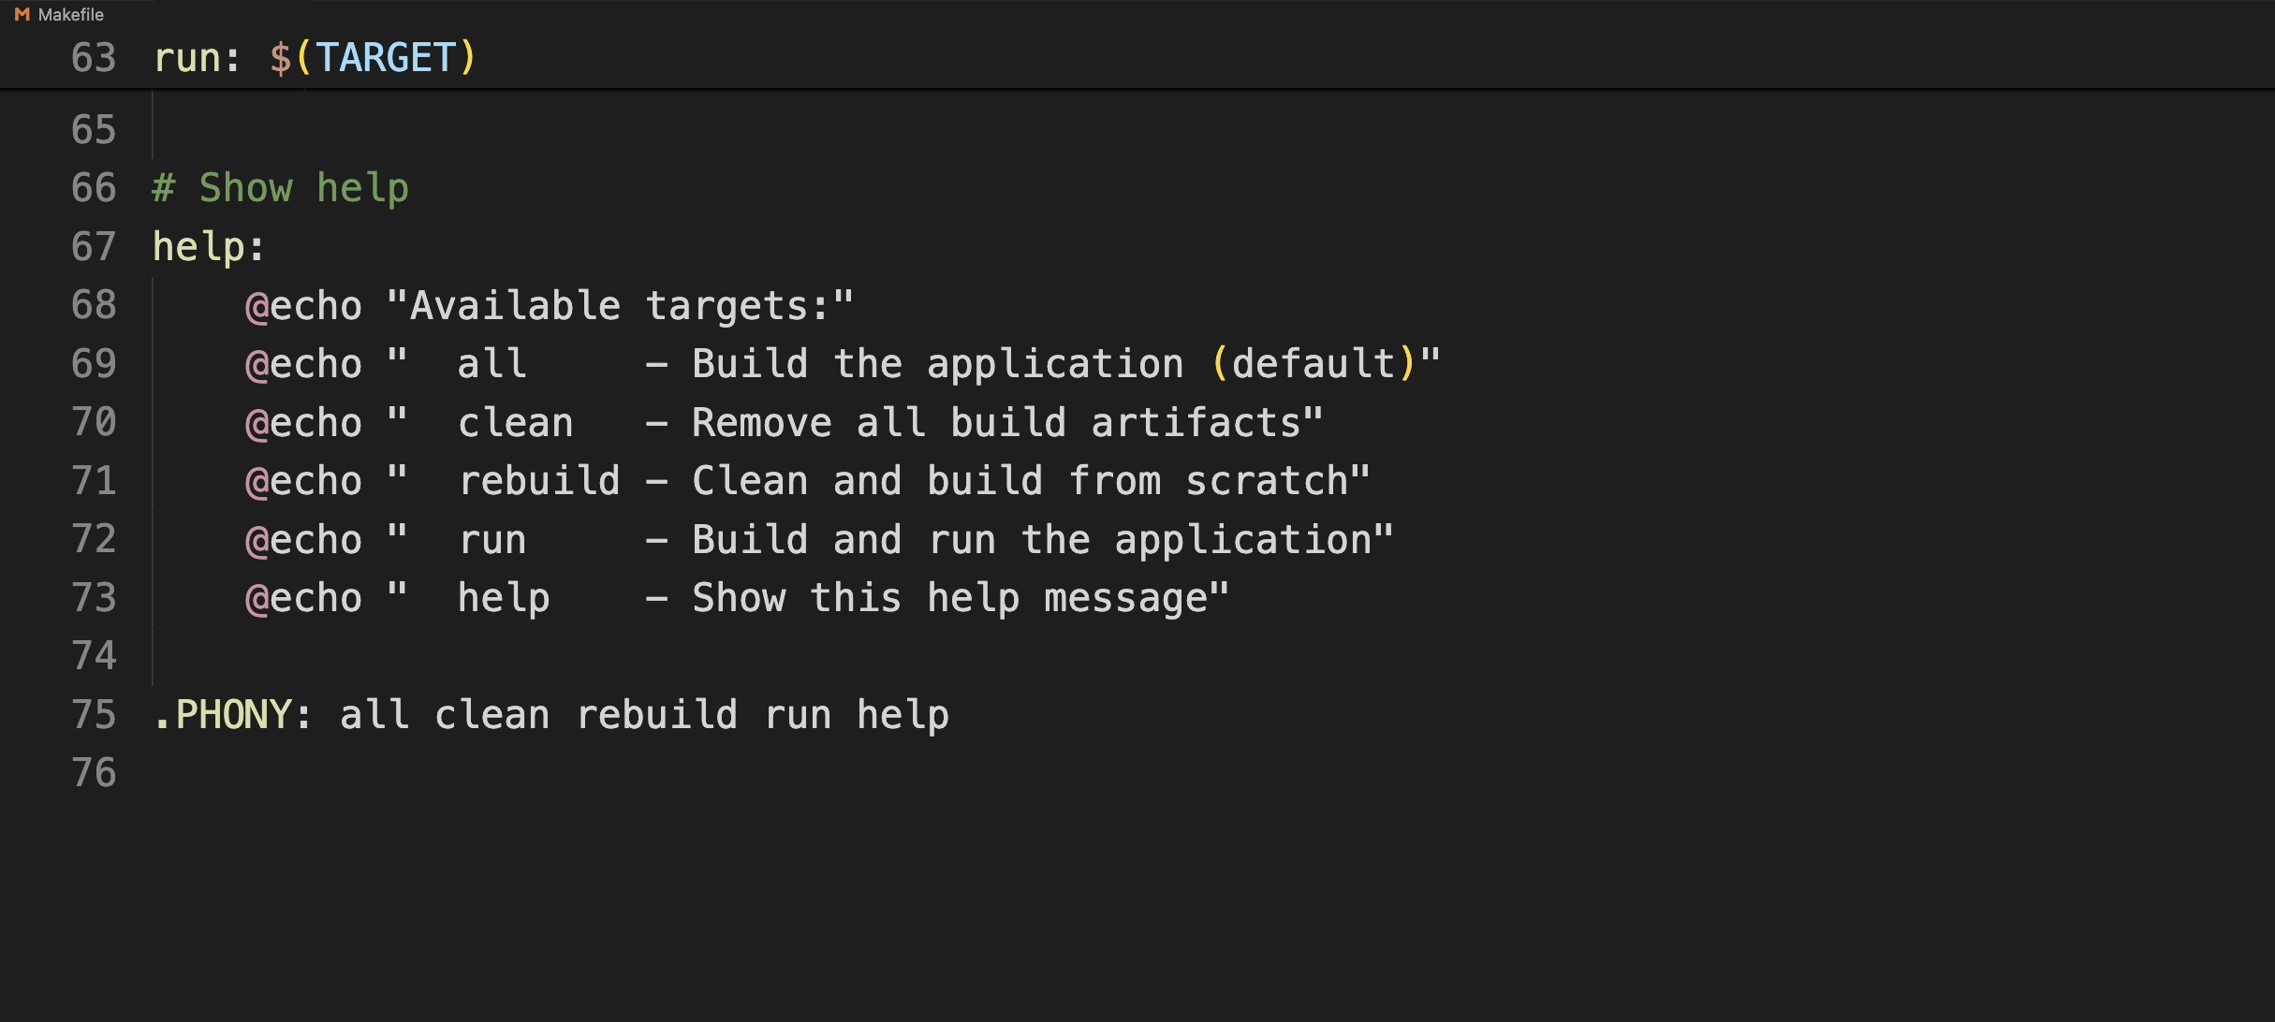
Towards a library - Stepping stone 6
Makefile 5/5 47..64
BiggerLibraryCMake

Slide 21
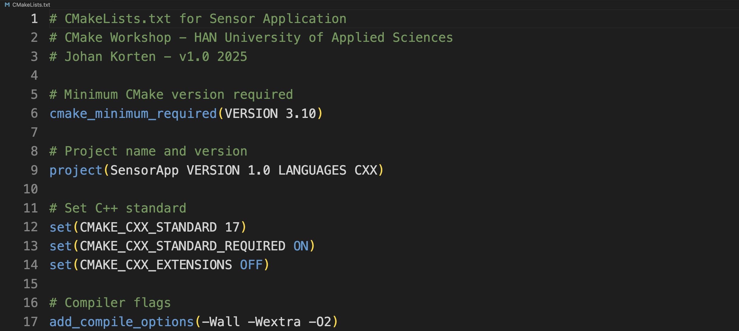
Towards a library - Stepping stone 6
CMakeLists.txt
1/2 1..17
BiggerLibraryCMake

Slide 22
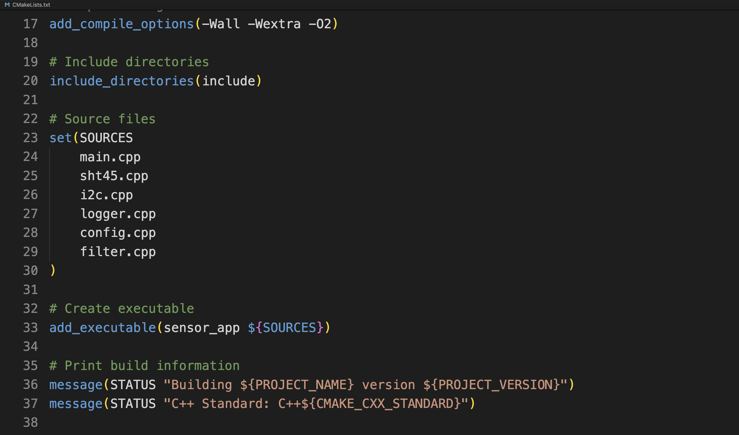
Towards a library - Stepping stone 6
CMakeLists.txt
2/2 17..37
BiggerLibraryCMake

Slide 23
Makefile versus CMakeLists.txt
1. No manual .o file listing - CMake figures it out
2. No repetitive rules - One add_executable() does it all
3. Automatic dependency tracking - CMake scans headers
4. Cross-platform - Same file works on Windows/Linux/Mac
5. Modern build system - Generates Makefiles, Visual Studio projects, Ninja, etc.
Notes:
SOLID, Strong Cohesion, Weak Coupling

Slide 24
Makefile versus CMakeLists.txt
# Just list the sources
set(SOURCES
main.cpp
sht45.cpp
i2c.cpp
logger.cpp
config.cpp
filter.cpp
)
# CMake figures out the rest!
add_executable(sensor_app ${SOURCES})
Notes:
SOLID, Strong Cohesion, Weak Coupling

Slide 25
The problem of makefiles
‘Makefile hell’: 200+ lines for a simple project
IDE lock-in: Can't share code between STM32CubeIDE / VS Code / CLion / whatever.
Notes:
SOLID, Strong Cohesion, Weak Coupling

Slide 26
The Solution
‘Makefile hell’: 200+ lines for a simple project
IDE lock-in: Can't share code between STM32CubeIDE / VS Code / CLion / whatever.
Notes:
SOLID, Strong Cohesion, Weak Coupling

Slide 27
The problem of makefiles
‘Makefile hell’: 200+ lines for a simple project
IDE lock-in: Can't share code between STM32CubeIDE / VS Code / CLion / whatever.
Notes:
SOLID, Strong Cohesion, Weak Coupling

Slide 28
Clean code: Maintainability
Clean code versus Clean architecture
Notes:
Without a clean architecture, even the best clean code can become a tangled mess as the application grows. Without clean code, the architecture's benefits in terms of maintainability and flexibility are lost because the code within each layer is difficult to work with.
The difference between clean code and clean architecture?
16 Dec 2023 — It highlights the separation of concerns, independence from frameworks, and using abstractions for a clear and understa...
DEV Community
Clean Architecture - The Clean Code Blog - Uncle Bob
12 Aug 2012 — The Dependency Rule The concentric circles represent different areas of software. In general, the further in you go, th...
Clean Coder Blog
How to Write Clean Code – Tips and Best Practices (Full Handbook)
14 May 2023 — Clean code is a term used to describe computer code that is easy to read, understand, and maintain. Clean code is writt...
freeCodeCamp
Show all

Slide 29
A few reasons why do we need clean code…
All software:
- Maintainability (Code is read 10x more than written)
- Collaboration (Teams need shared understanding)
- Especially embedded:
- Safety - Lives depend on it (medical, automotive, aerospace)
- Certification - IEC 62304, ISO 26262, DO-178C compliance required
- Resource constraints - Limited RAM/ROM, no dynamic allocation
- Longevity - Products run 10-20+ years unchanged (e.g. MOBA)
- Debugging difficulty - No printf, limited tooling, real-time constraints
- Efficiency - E.g. battery life, etc.

Slide 30
When Code Quality Kills 1/2
Case 1: Therac-25 (1985-1987)
The Incident:
Radiation therapy machine delivered doses 100x higher than intended
At least 6 accidents between 1985-1987
3 patients died, others severely injured
Code Problems:
Race condition: changing treatment mode within 8 seconds left turntable in wrong position
One-byte flag overflow: every 256th increment reset safety check to zero
Hardware safety interlocks removed, relying solely on software
Reused code from previous machines (Therac-6, Therac-20) without hardware safeguards
Cryptic error messages ("MALFUNCTION 54") with no documentation
No formal specifications, design documents, or test plans
Notes:
References:
Leveson, N. G., & Turner, C. S. (1993). An Investigation of the Therac-25 Accidents. Computer, 26(7), 18-41.
Full case study: https://web.stanford.edu/class/archive/cs/cs240/cs240.1236/old//sp2014/readings/therac-25.pdf

Slide 31
When Code Quality Kills 2/2
Case 2: Toyota Unintended Acceleration (2000s-2010)
The Incident:
Reports of unintended acceleration led to investigation
NHTSA estimated 89 deaths in the prior decade (by 2010)
$3+ billion in settlements and fines
Multiple recalls involving millions of vehicles
The Code Problems:
[Error cannot fit on single slide ;)]
Notes:
References:
Leveson, N. G., & Turner, C. S. (1993). An Investigation of the Therac-25 Accidents. Computer, 26(7), 18-41.
Full case study: https://web.stanford.edu/class/archive/cs/cs240/cs240.1236/old//sp2014/readings/therac-25.pdf

Slide 32
When Code Quality Kills 2/2 (Toyota Unintended Acceleration)
Case 2: Toyota Unintended Acceleration (2000s-2010)
The Code Problems (NASA Investigation (2010-2011)):
Found 7,134 MISRA-C violations (checking only 35 of 127 rules)
347 violations of subset of MISRA-C rules they checked
243 violations of NASA's own "Power of 10" safety rules
Concluded: no definitive electronic cause found, but system was highly complex
Civil Litigation Expert Analysis (2013): Michael Barr's team found in 2005 Camry code:
81,514 MISRA-C violations (checking full 2004 ruleset)
11,000 global variables
67 functions rated "untestable" (cyclomatic complexity >50)
Stack overflow risks (94% usage, not 41% as Toyota claimed)
Critical variables not mirrored for safety
No watchdog protection on critical task
Recursion in safety-critical code (MISRA violation)
Toyota's Standards: Used only 11 of 127 MISRA-C rules; violated 5 of those 11
Notes:
Court Outcome: 2013 Oklahoma jury ruled Toyota's software was "defective and unreliable" and caused fatal crash
References:
NASA Engineering and Safety Center (2011). Technical Assessment of Toyota Electronic Throttle Control Systems
Barr, M. (2013). Expert Report, Bookout v. Toyota Motor Corp.
EDN article: https://www.edn.com/toyotas-killer-firmware-bad-design-and-its-consequences/
Barr Group case study: https://barrgroup.com/software-expert-witness/case-studies/car-unintended-acceleration

Slide 33
When Code Quality Kills: Resume
Both cases show:
"It compiles" ≠ "It's safe"
Standards exist for reasons - written in blood
Testing alone is insufficient - code must be maintainable and verifiable
Overconfidence kills - both companies dismissed early warnings
These weren't syntax errors. These were design and process failures that standards like MISRA specifically prevent. Let's learn what those standards are and why they matter."
Notes:
Court Outcome: 2013 Oklahoma jury ruled Toyota's software was "defective and unreliable" and caused fatal crash
References:
NASA Engineering and Safety Center (2011). Technical Assessment of Toyota Electronic Throttle Control Systems
Barr, M. (2013). Expert Report, Bookout v. Toyota Motor Corp.
EDN article: https://www.edn.com/toyotas-killer-firmware-bad-design-and-its-consequences/
Barr Group case study: https://barrgroup.com/software-expert-witness/case-studies/car-unintended-acceleration

Slide 34
When Code Quality Kills: Resume
From SOLID to safety-critical coding:
- SOLID helps with maintainability, but embedded systems need more…
- Clean code matters differently in embedded: safety, certification, resource constraints
Notes:
Court Outcome: 2013 Oklahoma jury ruled Toyota's software was "defective and unreliable" and caused fatal crash
References:
NASA Engineering and Safety Center (2011). Technical Assessment of Toyota Electronic Throttle Control Systems
Barr, M. (2013). Expert Report, Bookout v. Toyota Motor Corp.
EDN article: https://www.edn.com/toyotas-killer-firmware-bad-design-and-its-consequences/
Barr Group case study: https://barrgroup.com/software-expert-witness/case-studies/car-unintended-acceleration

Slide 35
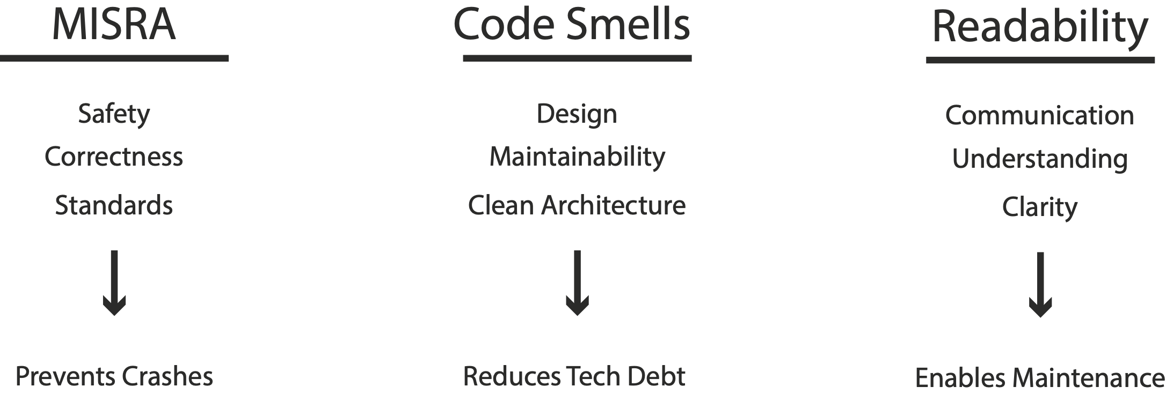
Trade-offs: why software engineering vs programming or computer science
Performance vs safety, readability vs efficiency
Notes:
MISRA C++ 2023

Slide 36
MISRA Compliance on C++:
“While popular, no programming language can guarantee that the final executable code will behave exactly as the developer intended.
The language has several drawbacks which are discussed in the following sub-sections.”
Notes:
MISRA C++ 2023

Slide 37
MISRA Compliance on C++: Essentials
Essential MISRA Reading in a C++ context:
Chapter 2: "Disadvantages of C++" - discusses why standards are needed
Chapter 4: Type conversions and casts
Chapter 6: Basic concepts (particularly control flow)
Chapter 8: Declarations and definitions
Chapter 15: Resource management (RAII)
Notes:
MISRA C++ 2023

Slide 38
MISRA Compliance on C++: Essentials
Chapter 2: "Disadvantages of C++" - discusses why standards are needed
Undefined Behavior: C++ has many cases where behavior is not specified by the standard (buffer overflows, dereferencing null pointers, signed integer overflow)
Implementation-Defined Behavior: Compiler-specific behaviors that can vary
Unspecified Behavior: Standard allows multiple valid outcomes
Complexity: C++ is a large, complex language with many features that can interact in unexpected ways
Backward Compatibility: Legacy features retained for compatibility can be dangerous in safety-critical contexts
Lack of Built-in Safety: No automatic bounds checking, memory management, or initialization
Standards like MISRA restrict the language to a safer, more predictable subset by eliminating undefined behaviors and dangerous constructs.
Notes:
MISRA C++ 2023

Slide 39
MISRA Compliance on C++: Essentials
Chapter 4: Type conversions and casts
Implicit Conversions Are Dangerous: Can lose data silently (int to unsigned, float to int, pointer conversions)
Signed/Unsigned Mixing: Major source of bugs in embedded systems
Narrowing Conversions: Losing precision without warning
Pointer Casts: Violate type safety and can cause alignment issues
MISRA Approach:
Prefer explicit casts over implicit conversions
Use static_cast for safe conversions
Avoid reinterpret_cast and C-style casts
Never cast away const
Notes:
MISRA C++ 2023

Slide 40
MISRA Compliance on C++: Essentials
Chapter 6: Basic concepts (particularly control flow)
Goto Considered Harmful: Makes code difficult to analyze and verify
Single Entry/Exit: Functions should have clear, predictable flow
Loop Bounds: All loops should have deterministic, analyzable bounds
Switch Statements: Must have default cases, no fall-through
Cyclomatic Complexity: Keep functions simple and testable
Notes:
MISRA C++ 2023
Cyclomatic Complexity: A software metric used to quantify the number of linearly independent paths through a program's source code.

Slide 41
MISRA Compliance on C++: Essentials
Chapter 8: Declarations and definitions
Initialization Is Mandatory: All variables must be initialized before use
Scope Minimization: Declare variables in smallest possible scope
One Declaration Per Line: Improves readability and reduces errors
Consistent Naming: Clear, meaningful names
Avoid Shadowing: Don't reuse names in nested scopes
Notes:
MISRA C++ 2023

Slide 42
MISRA Compliance on C++: Essentials
Chapter 15: Resource management (RAII)
RAII is Fundamental: Resources tied to object lifetime
No Naked new/delete: Use smart pointers
Deterministic Cleanup: Destructors must not fail
Exception Safety: Resources must be released even when exceptions occur
Manager Classes: Scoped, unique, and general managers for resource handling
Notes:
MISRA C++ 2023
RAII (Resource Acquisition Is Initialization) is a programming idiom where resource management is tied to an object's lifetime.

Slide 43
MISRA Compliance on C++: Violation Categories
Mandatory
Must be followed - No exceptions allowed
Cannot be deviated from under any circumstances
Typically covers critical safety issues or undefined behavior
Violation = Immediate failure in certification
Notes:
MISRA C++ 2023
RAII (Resource Acquisition Is Initialization) is a programming idiom where resource management is tied to an object's lifetime.

Slide 44
MISRA Compliance on C++: Violation Categories
Required (Most Common)
Should be followed - Deviations require formal justification
Can be deviated from, but you must:
1. Document why you're deviating
2. Provide technical justification
3. Get approval from project safety authority
4. Prove the deviation is safe
Covers important safety/quality issues
Notes:
MISRA C++ 2023
RAII (Resource Acquisition Is Initialization) is a programming idiom where resource management is tied to an object's lifetime.

Slide 45
MISRA Compliance on C++: Violation Categories
Advisory
Recommended - Should follow when practical
Deviations don't require formal documentation
Best practices that improve code quality
May have performance and/or practical trade-offs
Notes:
MISRA C++ 2023
RAII (Resource Acquisition Is Initialization) is a programming idiom where resource management is tied to an object's lifetime.

Slide 46
MISRA Compliance on C++: Examples
Disclaimer: the code examples show what pitfalls to avoid but sometimes also introduce other code smells (that is often done for simplicity reasons).
We will check our final example using the MISRA C++ 2023 rules and cppcheck!
Notes:
MISRA C++ 2023

Slide 47
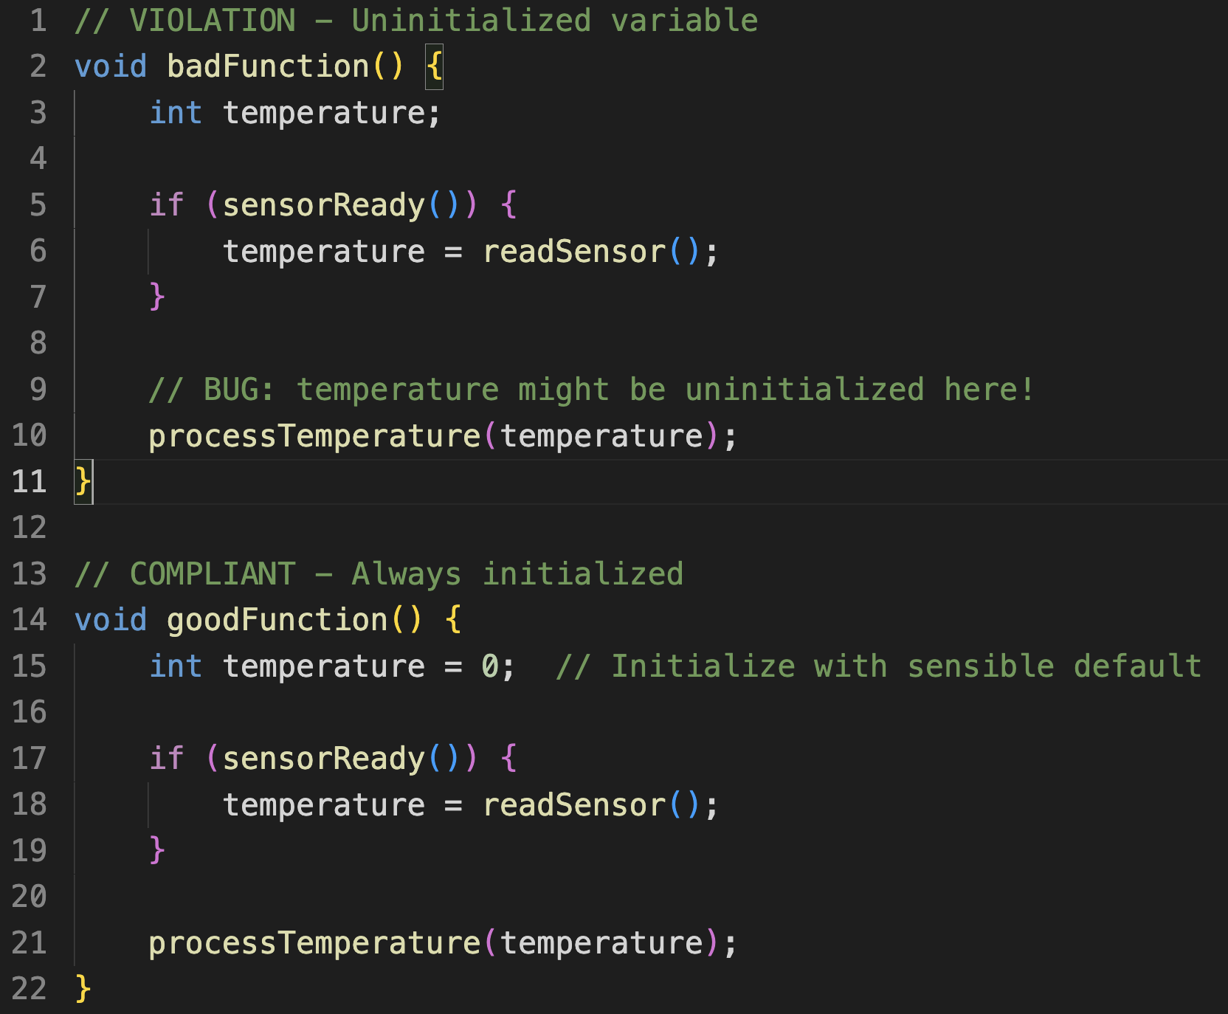
Example MISRA C++ Rule 8.4.1: A variable shall be initialized before it is read

Slide 48
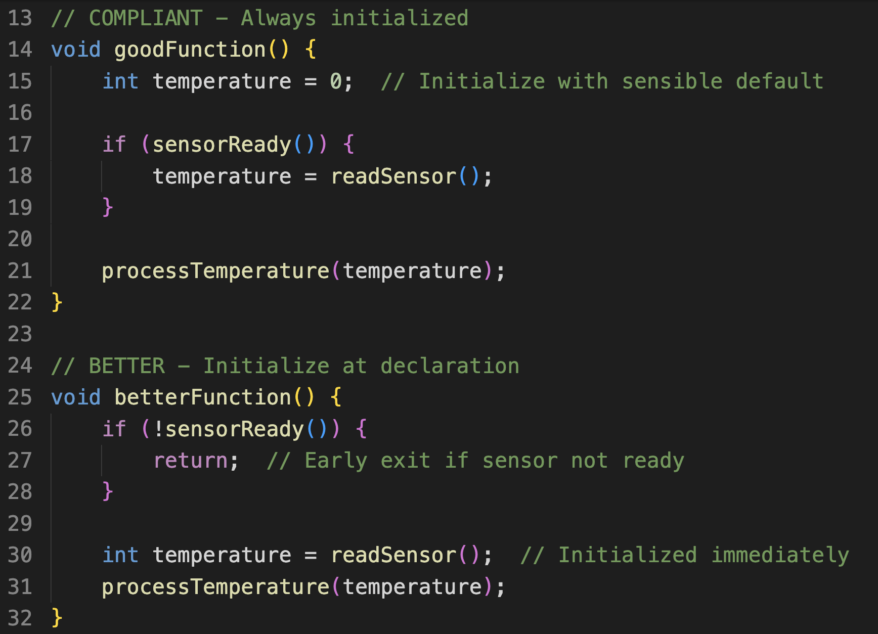
Example MISRA C++ Rule 8.4.1: A variable shall be initialized before it is read

Slide 49
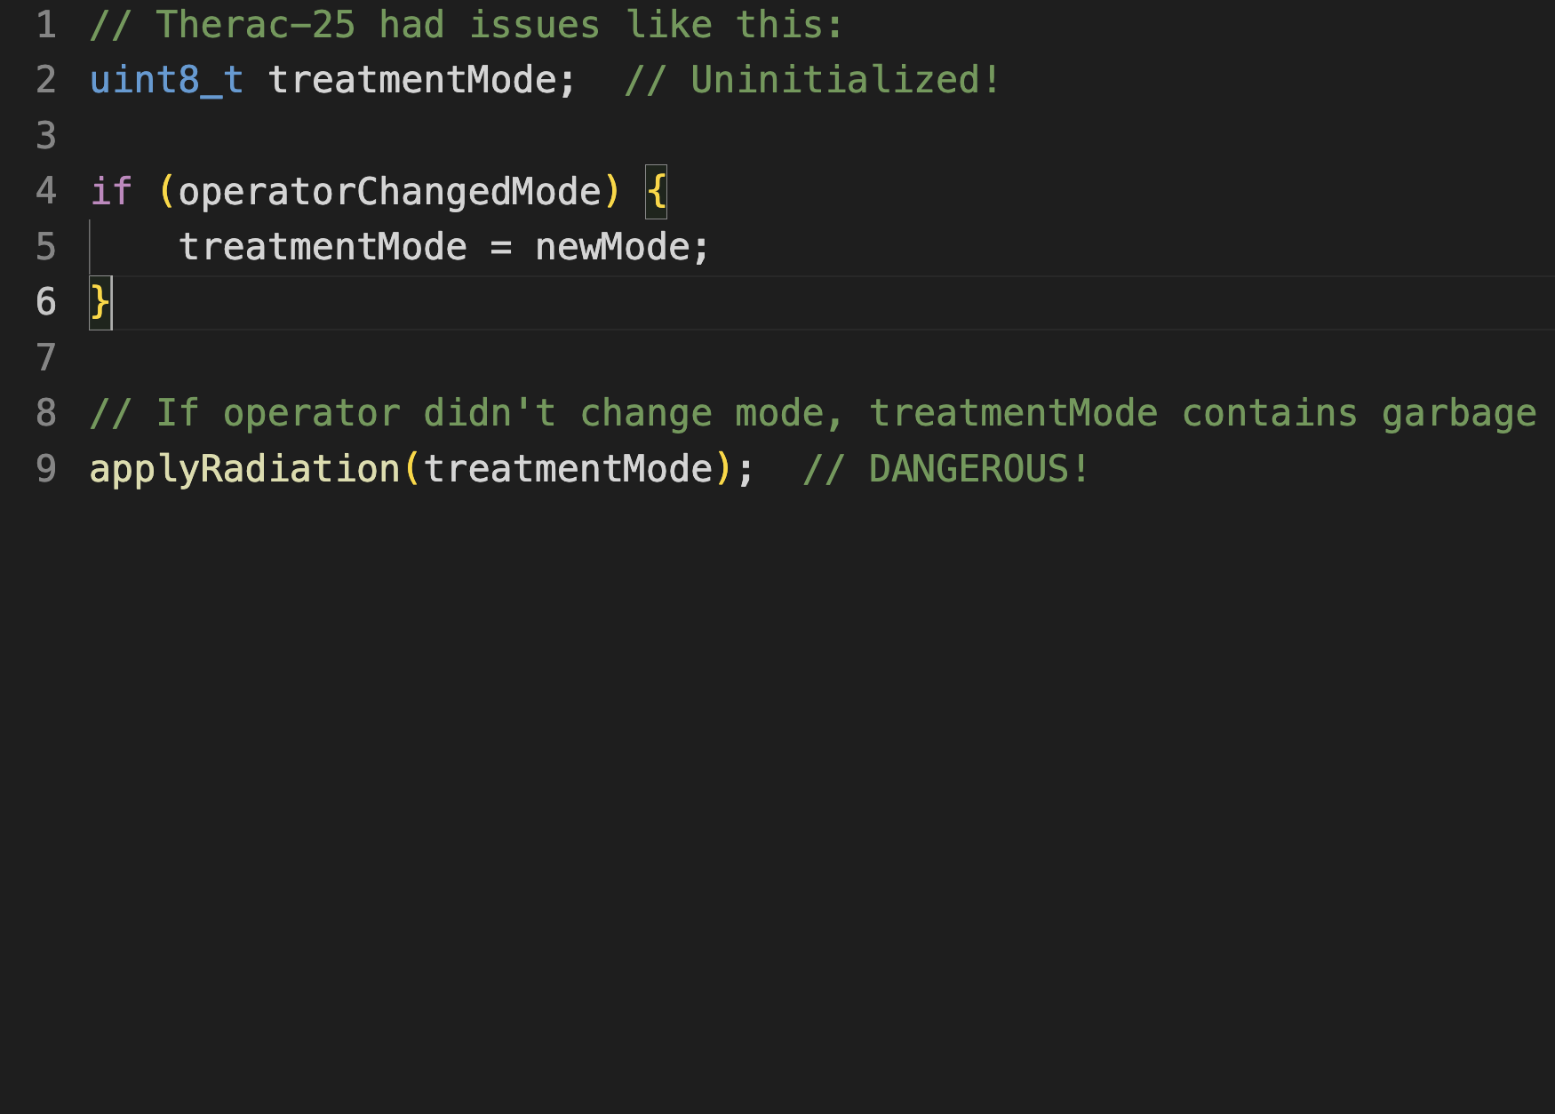
Example MISRA C++ Rule 8.4.1: A variable shall be initialized before it is read

Slide 50
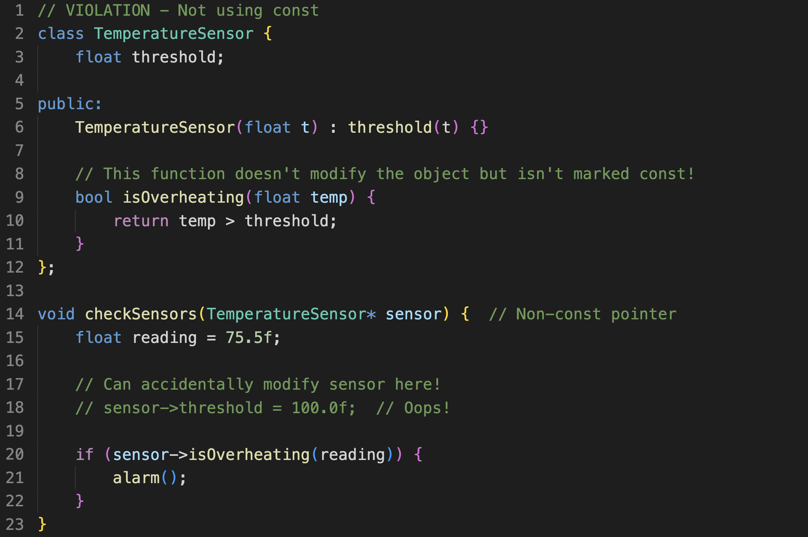
Example MISRA C++ Rule 7.1.1: A variable which is not modified shall be const qualified

Slide 51
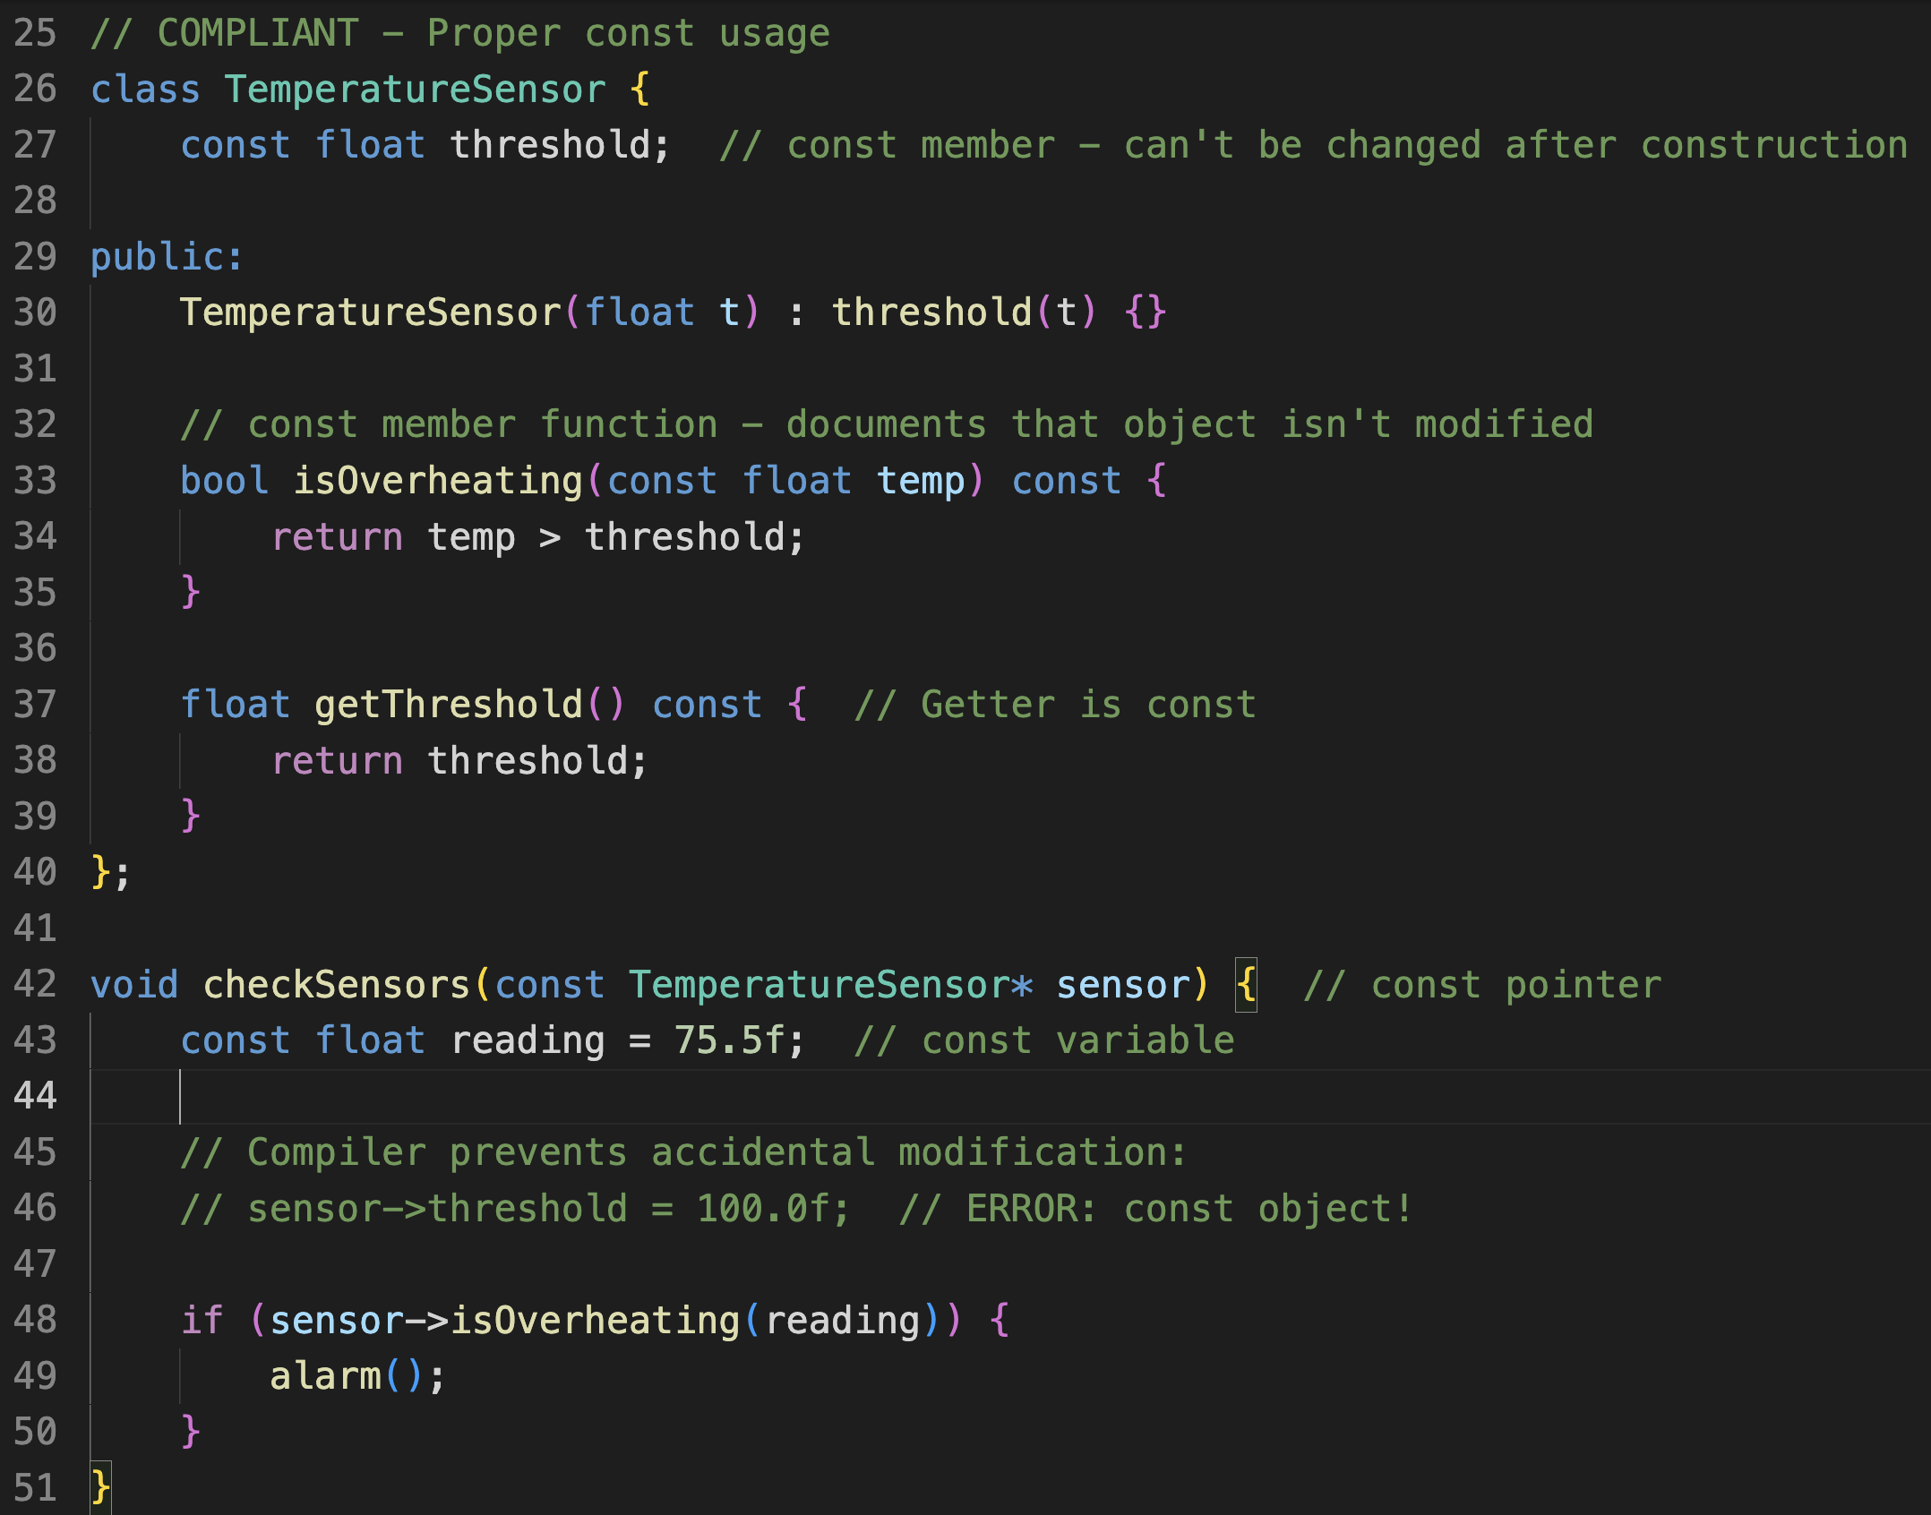
Example MISRA C++ Rule 7.1.1: A variable which is not modified shall be const qualified

Slide 52
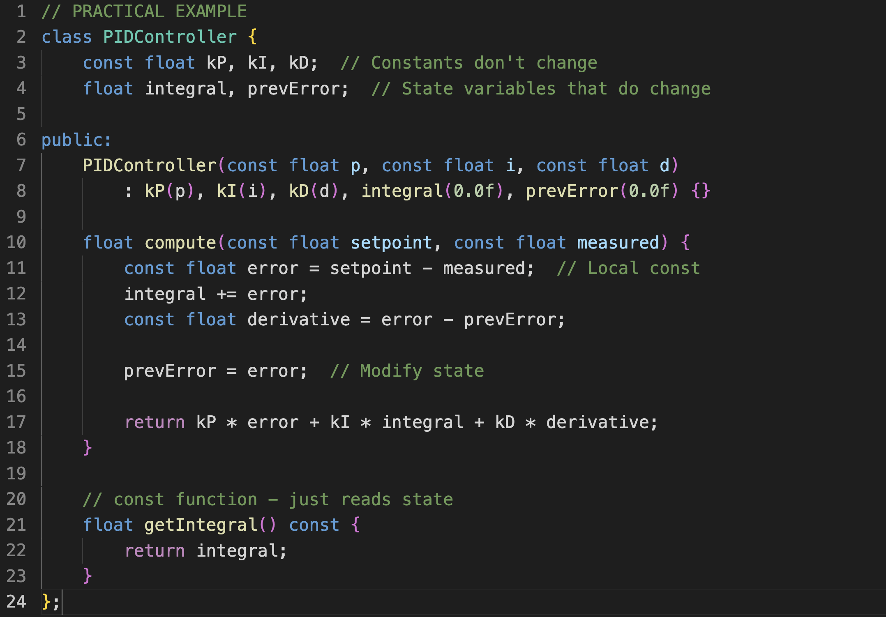
Example MISRA C++ Rule 7.1.1: A variable which is not modified shall be const qualified

Slide 53
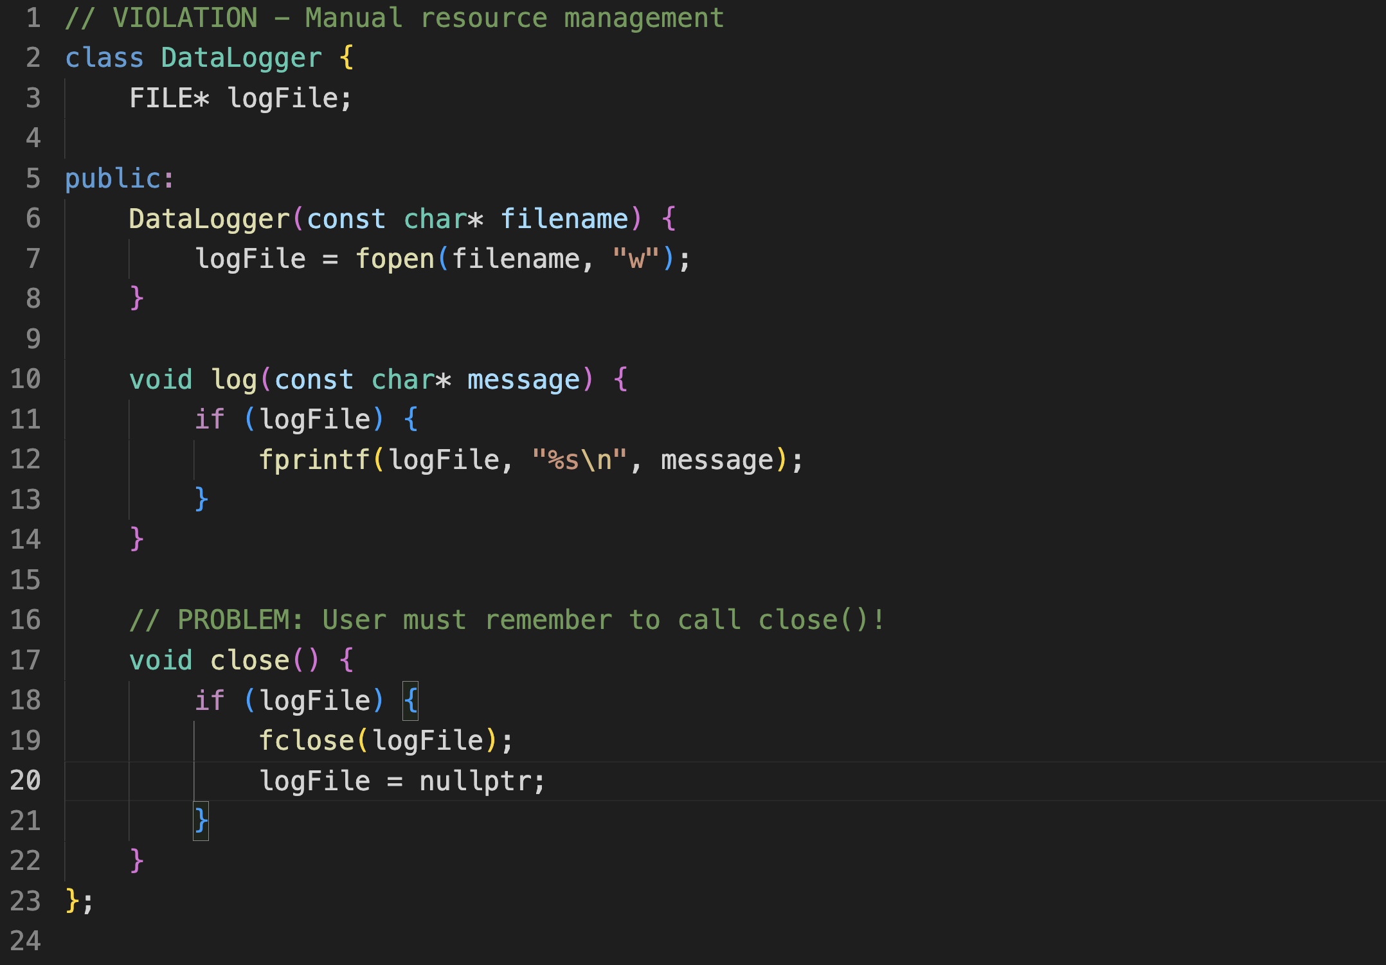
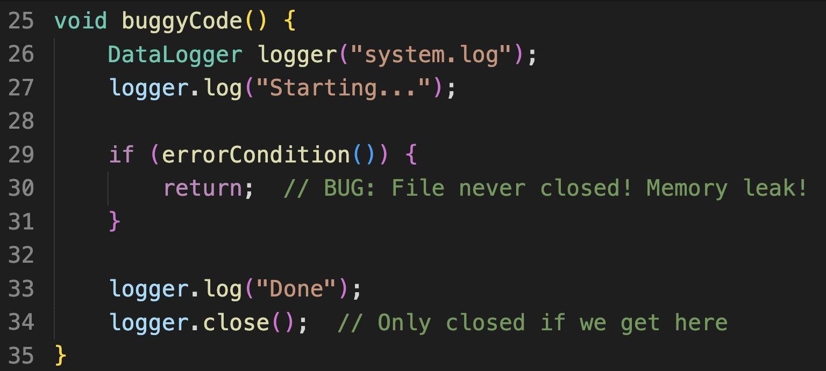
Example MISRA C++ Rule 15.0.1:
A class that appears to manage resources should use RAII

Slide 54
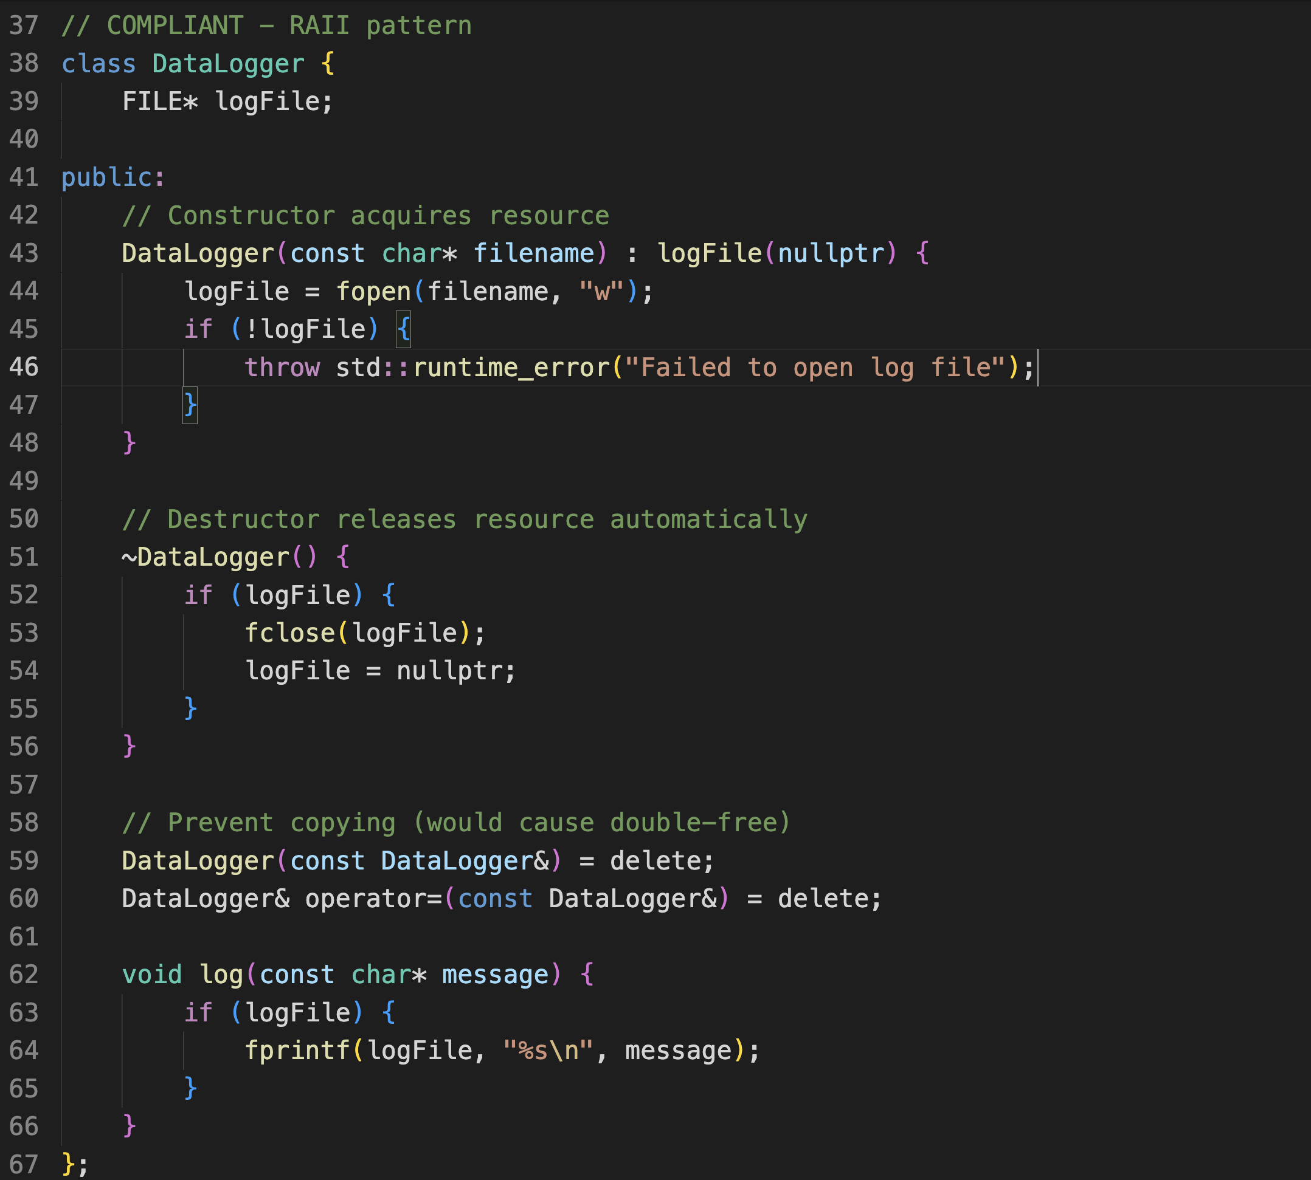
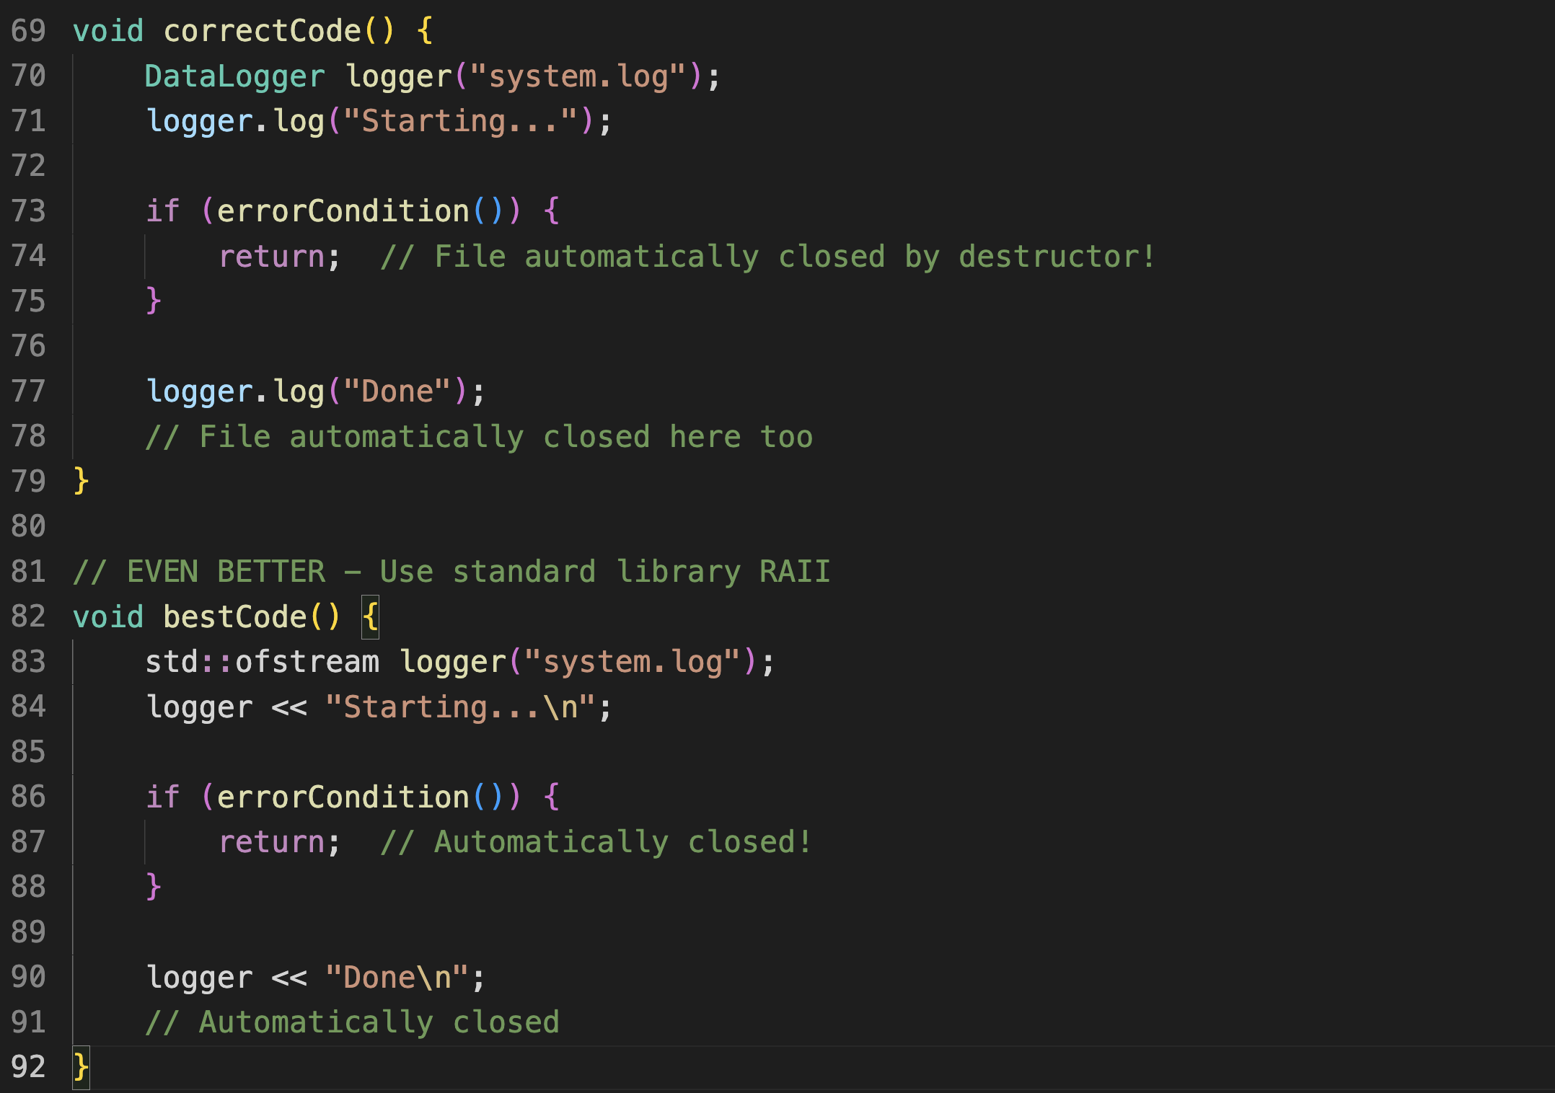
Example MISRA C++ Rule 15.0.1:
A class that appears to manage resources should use RAII

Slide 55
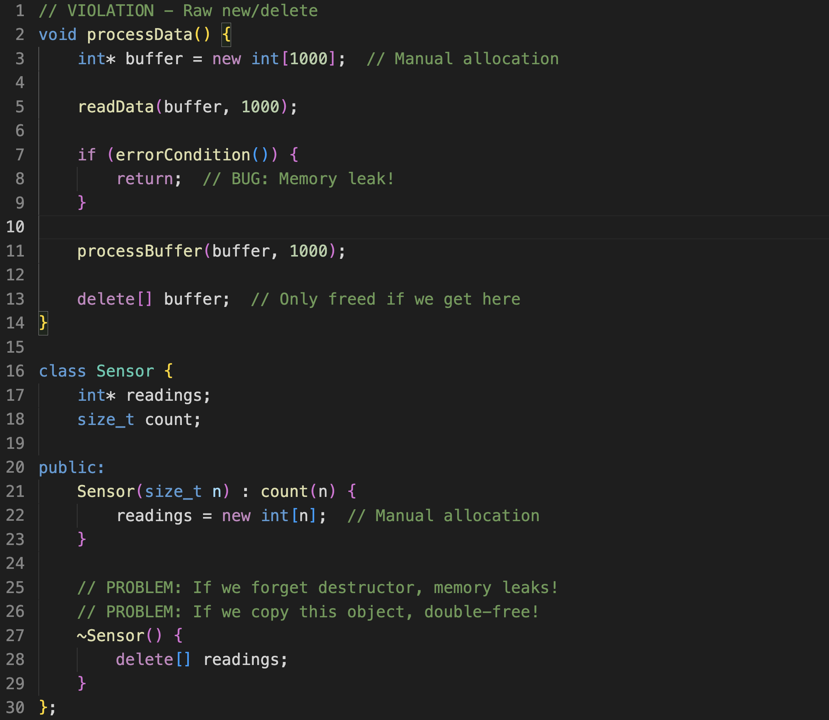
Example MISRA C++ Rule Rule
18.0.2: Do not use new or delete; use smart pointers instead

Slide 56
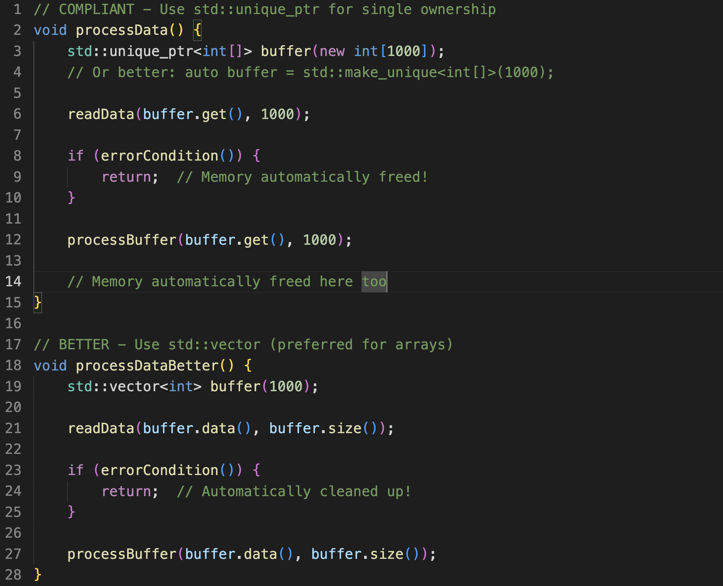
Example MISRA C++ Rule Rule
18.0.2: Do not use new or delete; use smart pointers instead

Slide 57
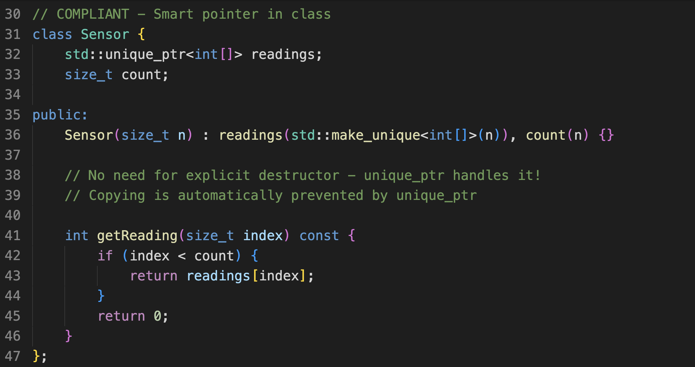
Example MISRA C++ Rule Rule
18.0.2: Do not use new or delete; use smart pointers instead

Slide 58
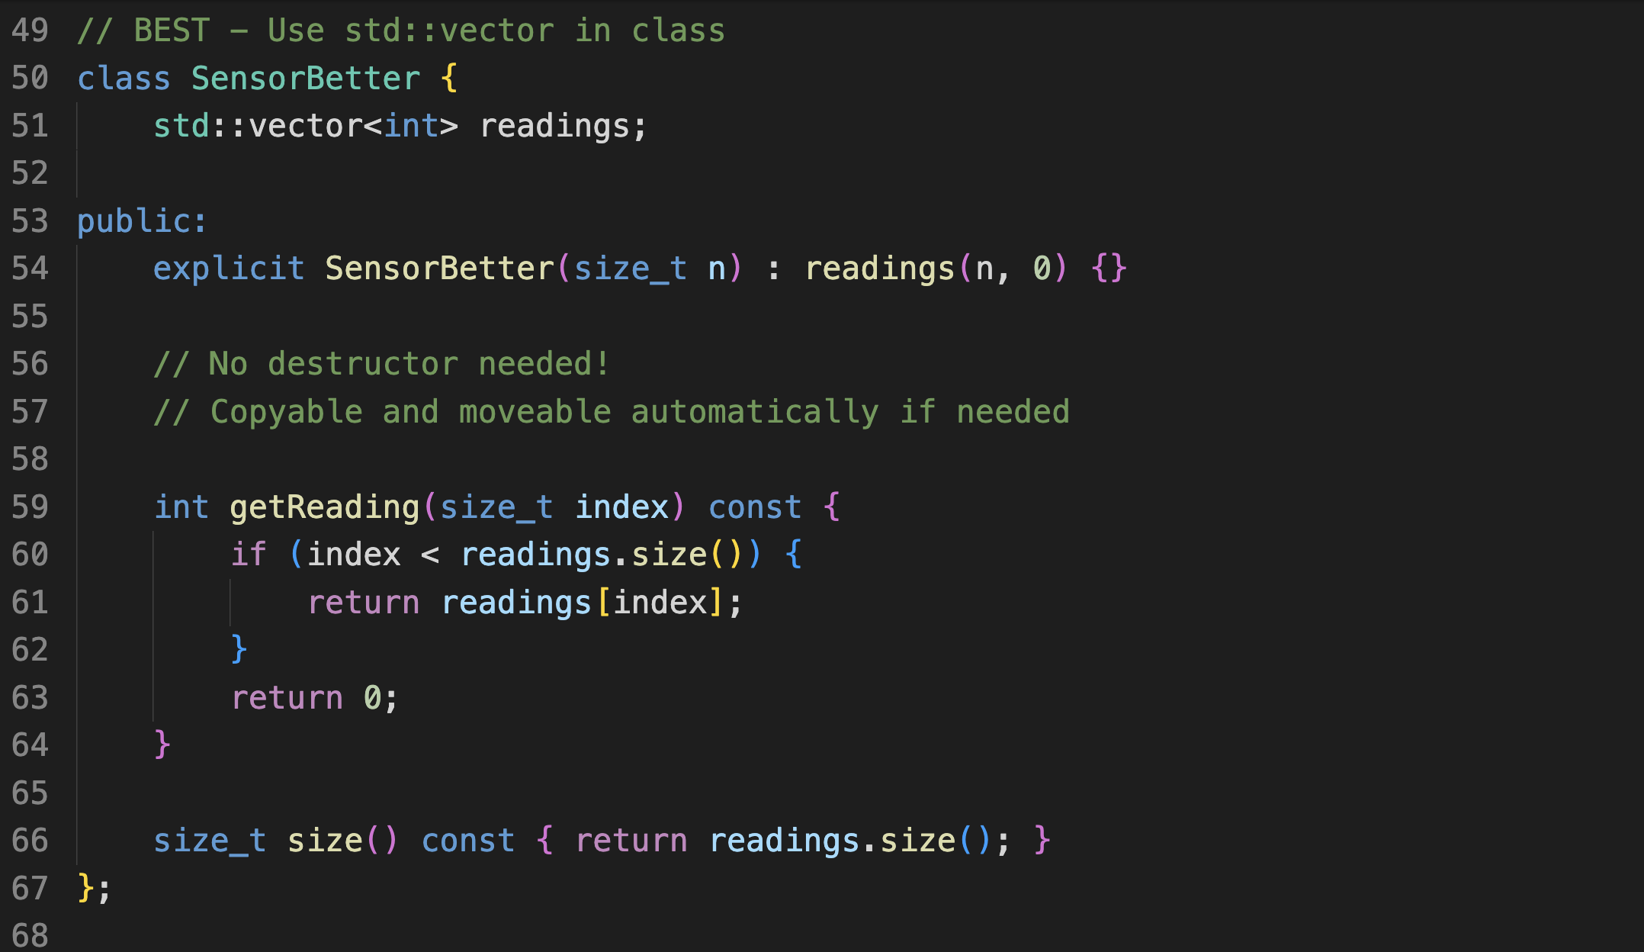
Example MISRA C++ Rule Rule
18.0.2: Do not use new or delete; use smart pointers instead

Slide 59
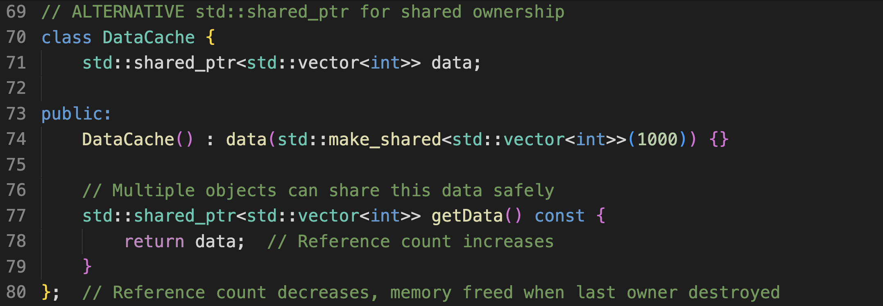
Example MISRA C++ Rule Rule
18.0.2: Do not use new or delete; use smart pointers instead

Slide 60
MISRA Compliance on C++:
Key Rules:
- Rule 8.4.1 (uninitialized variables)
- Rule 8.4.2 (no goto)
- Rule 7.1.1 (const correctness)
- Rule 15.0.1 (RAII)
- Rule 18.0.2 (no raw new/delete)
Notes:
MISRA C++ 2023

Slide 61
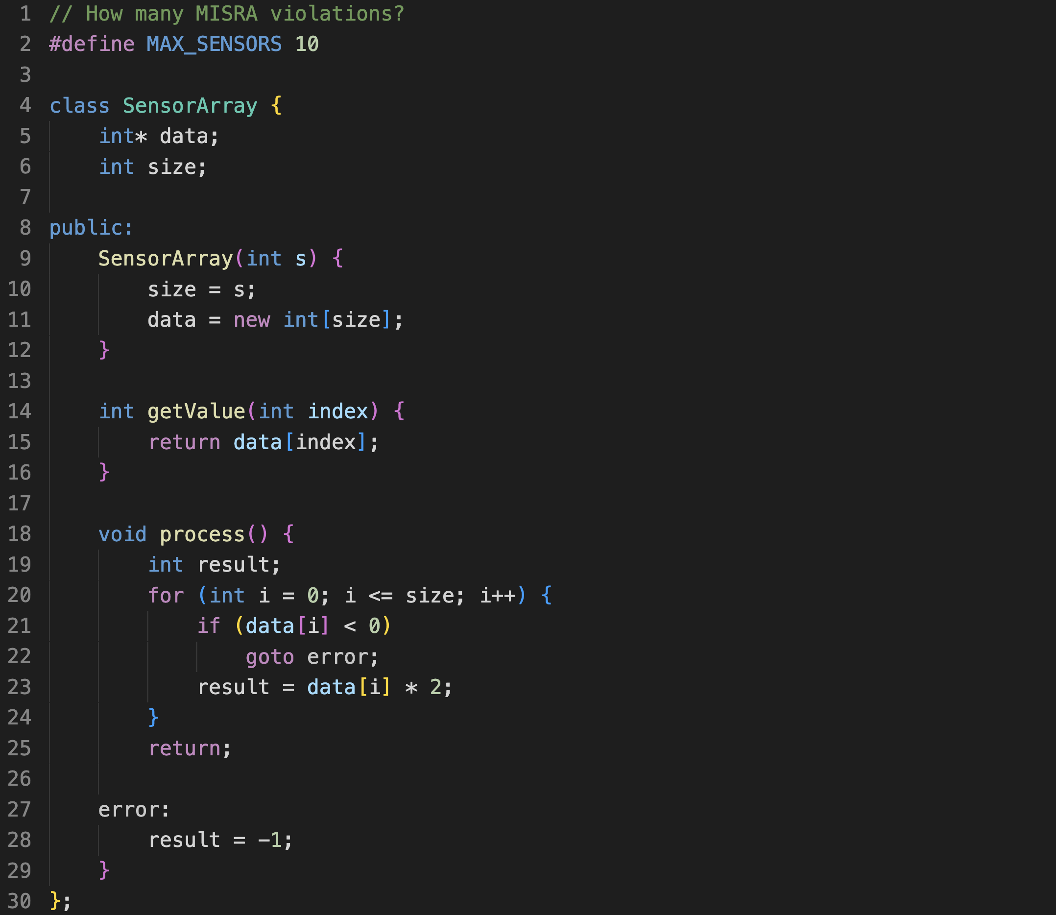
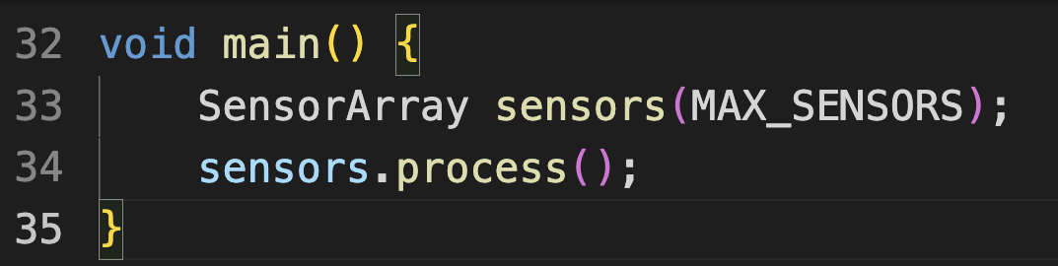

MISRA Violations Hunt
https://gist.github.com/jakorten/e9ffce1eb57fda54c74704e4bac91cd6

Slide 62
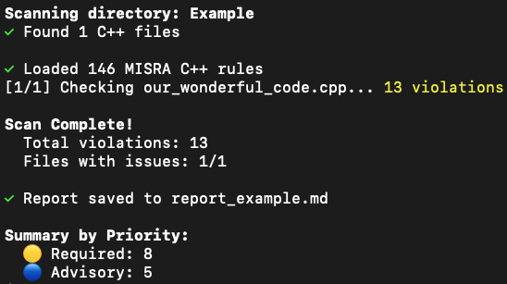
MISRA Compliance on C++:
Tip: in the Repo is also “MoreCode_Anonymized” you could also try to check for violations.
Note: it is very, very likely to find violations in ALL our (more serious) code, that is not the point!!!
Notes:
MISRA C++ 2023

Slide 63
More on (static) code checking:
# MISRA Checking Quick Reference
## Free Tools (Use in practice)
- cppcheck --enable=all mycode.cpp
- clang-tidy mycode.cpp -- -std=c++17
- gcc/clang with: -Wall -Wextra -Wpedantic -Werror
## What They Check (MISRA-like)
✓ Uninitialized variables
✓ Memory leaks
✓ Null pointer dereferences
✓ Buffer overflows
✓ Dead code
✓ Complexity metrics
## What They Miss (Need commercial tools)
✗ Full MISRA rule compliance
✗ Certification-grade reports
✗ Deep flow analysis
Notes:
MISRA C++ 2023

Slide 64
How do we check our code…
CPPCheck cpplint to check Google C++ Style Guide compliance
and other static code analyzers
Remember: they are just one of many in our bag of tools.
More on this next week!
Notes:
MISRA C++ 2023

Slide 65
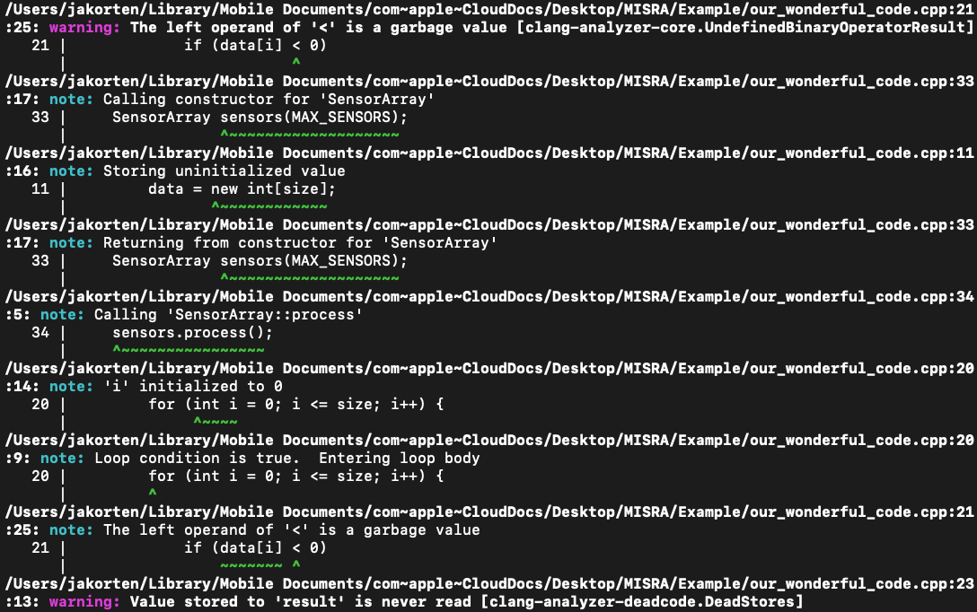
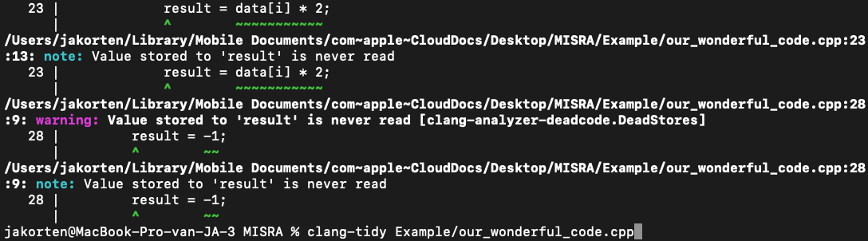
Clang-tidy
clang-tidy Example/our_wonderful_code.cpp

Slide 66
Readibility
Clean code is simple and direct.
Clean code reads like well-written prose.
Clean code never obscures the designer's intent but rather is full of crisp abstractions and straightforward lines of control.”
- Grady Booch author of Object Oriented Analysis and Design with Applications (Booch, Jacobson and Rumbaugh were behind UML)
Notes:
MISRA C++ 2023

Slide 67
Kent Beck: Order matters!
Code is written once but read hundreds of times. Write for the hundreds of times.” - Kent Beck
- First: Make it WORK (on target hardware; correctness)
- Second: Make it RIGHT (safe, maintainable)
- Make it FIT (within memory constraints)
- Make it FAST (meet real-time deadlines)
Notes:
MISRA C++ 2023

Slide 68
Kent Beck: Habits
"I'm not a great programmer; I'm just a good programmer with great habits."
The habits:
✅ Write tests
✅ Refactor continuously
✅ Name things carefully
✅ Keep it simple
✅ Make it readable
Notes:
MISRA C++ 2023

Slide 69
Trade-offs: why software engineering vs programming or computer science
Exercise 1: "Spot the Issues"
Give students the bad code, ask them to find:
5 MISRA violations
5 code smells
Which ones overlap?
Exercise 2: "Prioritize the Fixes"
Which would you fix first? Why?
Safety vs maintainability trade-offs
Exercise 3: "Refactor Step-by-Step"
Start with bad code
Fix MISRA violations
Remove code smells
Compare: did fixing one help the other?
Notes:
MISRA C++ 2023

Slide 70
Trade-offs: why software engineering vs programming or computer science
Combat "vibe coding": Emphasize that these aren't arbitrary rules - each has a failure case. Show real bugs that resulted from violations.
Make it embedded-relevant: Use examples from Arduino/microcontroller context they know - ISRs, hardware registers, timing-critical code.
Notes:
MISRA C++ 2023

Slide 71
Code style: Naming Conventions
C++ Code Style Best Practices
Classes: PascalCase (e.g., SensorController, MotorDriver)
Functions/methods: camelCase (e.g., readSensor(), calculateSpeed())
Variables: camelCase (e.g., sensorValue, targetPosition)
Constants: UPPER_SNAKE_CASE (e.g., MAX_SPEED, DEFAULT_TIMEOUT)
Member variables: prefix with m_ (e.g., m_currentState, m_sensorData)
Notes:
MISRA C++ 2023

Slide 72
Code style: Code Quality
Always use const for values that don't change
Prefer references (&) over pointers when ownership isn't transferred
Initialize variables at declaration
Avoid magic numbers - use named constants
Write self-documenting code with clear names
(And of course the rest that we already discussed)
Notes:
MISRA C++ 2023

Slide 73
Code style: Comments (later workshop)
Explain why, not what (code shows what)
Document complex algorithms and hardware interactions
Keep comments up-to-date with code changes
Notes:
MISRA C++ 2023

Slide 74
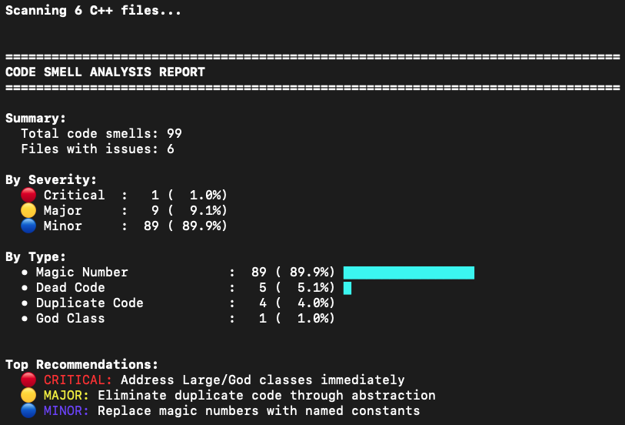
Code smells
python3 code_smell_scanner.py MoreCode_Anonymized

Slide 75
Code style
Of course companies might have their own style guidelines with do’s and don’ts!
Notes:
MISRA C++ 2023

Slide 76
Code style at file level
Kolpackov's "Canonical Project Structure" (ISO C++ Paper P1204R0, 2018) argues that split layouts make "navigating between corresponding headers and sources cumbersome" and that "in practice, private headers are placed into include/, defeating the purpose”
Notes:
MISRA C++ 2023

Slide 77
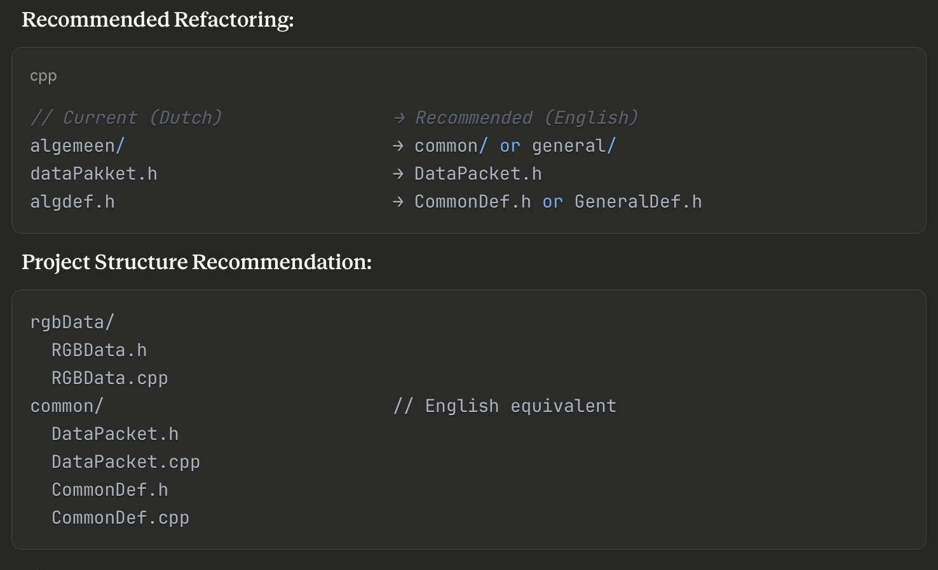
Code style: mixing (natural) languages
Sutter & Alexandrescu (2005): Coding standards promote consistency and international collaboration Micro-os-plus
Google C++ Style Guide: Emphasizes clear, unambiguous naming for global readability Google
JSF AV C++ (Safety-critical standard): Consistent, descriptive English identifiers required Bjarne Stroustrup
Bottom Line: For embedded systems that may be maintained internationally or in professional contexts, English identifiers are mandatory. Dutch variable names create barriers to code review, collaboration, and professional development.
Notes:
MISRA C++ 2023

Slide 78
Take away message
Starting today, write code that is:
✅ Safe (MISRA)
✅ Maintainable (No smells)
✅ Readable (Clear intent)
Don't just make it work. Make it RIGHT.

Slide 79
https://github.com/AEAEmbedded/ESE_PROG/tree/main/Workshops

Slide 80
Great Resources
C++ Core Guidelines (Stroustrup et al., ISO C++ Standards Committee)
Sutter & Alexandrescu (2005): C++ Coding Standards: 101 Rules, Guidelines, and Best Practices
JSF AV C++ (Lockheed Martin, 2005): Safety-critical embedded systems standard (221 rules)
MISRA C++:2023: Automotive/medical device coding guidelines for critical systems
Google C++ Style Guide: Industry best practices for large-scale development
Kolpackov's "Canonical Project Structure" (ISO C++ Paper P1204R0, 2018)
Sutter & Alexandrescu (2005): Coding standards promote consistency and international collaboration

Slide 81
That’s all…
Any questions?

